Slide 1



Every day getting better in every way…together!
Vertical Group Teaching

Slide 2



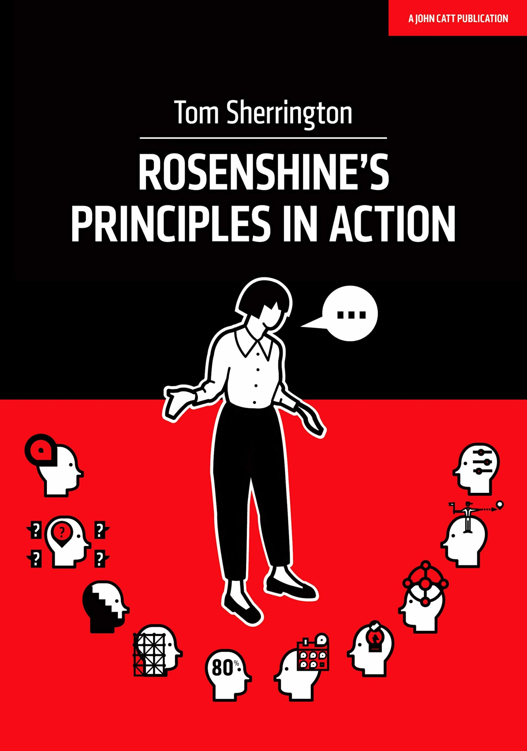

Curriculum Story So Far…
Curriculum developed further by subject leads including implementation of ‘Sticky Knowledge’ – 2020 - 2024
Ofsted recognises ‘powerful’ curriculum, but more could be done to ensure children have the opportunities to deepen their learning further
New bespoke curriculum written by Senior Leaders - 2020

Slide 3

What is Vertical Group Teaching?
Vertical group teaching means bringing children from different year groups together, allowing teachers to focus on where each child is in their learning journey in terms of stage, rather than just what age they are.
Key features:
Mixed-age groupings (Y1 & Y2)
Teaching through shared concepts and skills
Learning activities matched to individual readiness and challenge
Collaborative learning that builds confidence, empathy and leadership
Notes:
Notes to presenter:
What steps will you be taking as a result of this learning experience?
Did you learn from any failed experiences? How will you do things differently?
What advice will you give to others so they can learn from your experiences?
How can you share what you learned with a real-world audience?
Some examples of next steps might be:
After delivering my first persuasive presentation, I am thinking about joining the debate team.
After making my first film, I’m considering entering it in our school film festival or local film festival.
After connecting with this career expert, I’d like to do some research on that career field because it sounds interesting to me.
This SmartArt allows you add images and text to help outline your process. If a picture is worth a thousand words, then pictures and words should help you communicate this reflection on learning perfectly! You can always click on Insert>SmartArt to change this graphic or select the graphic and click on the Design contextual menu to change the colors.
Feel free to use more than one slide to share your next steps. It also helps to add some video content to explain your message.

Slide 4



The GTS Way – Stages of Learning
Surface Knowledge – Building strong foundations and key skills; learning the core knowledge securely.
Deeper Knowledge – Making connections, explaining understanding and applying knowledge to new situations.
Adventurer Knowledge – Going beyond, exploring ideas independently, solving problems and thinking creatively.

Slide 5
GTS Curriculum: History Key Stage 1

Slide 6

KS1 History - National Curriculum Objectives
Pupils should be taught about:
• Changes within living memory. Where
appropriate, these should be used to reveal
aspects of change in national life
• Events beyond living memory that are
significant nationally or globally
• The lives of significant individuals in the past
who have contributed to national and
international achievements.
• Significant historical events, people and places
in their own locality.

Slide 7
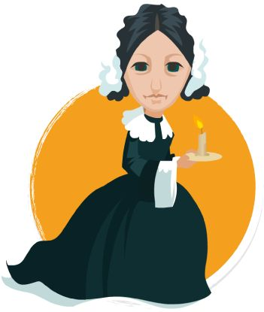
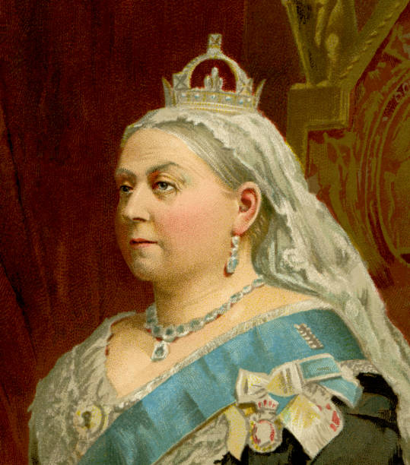
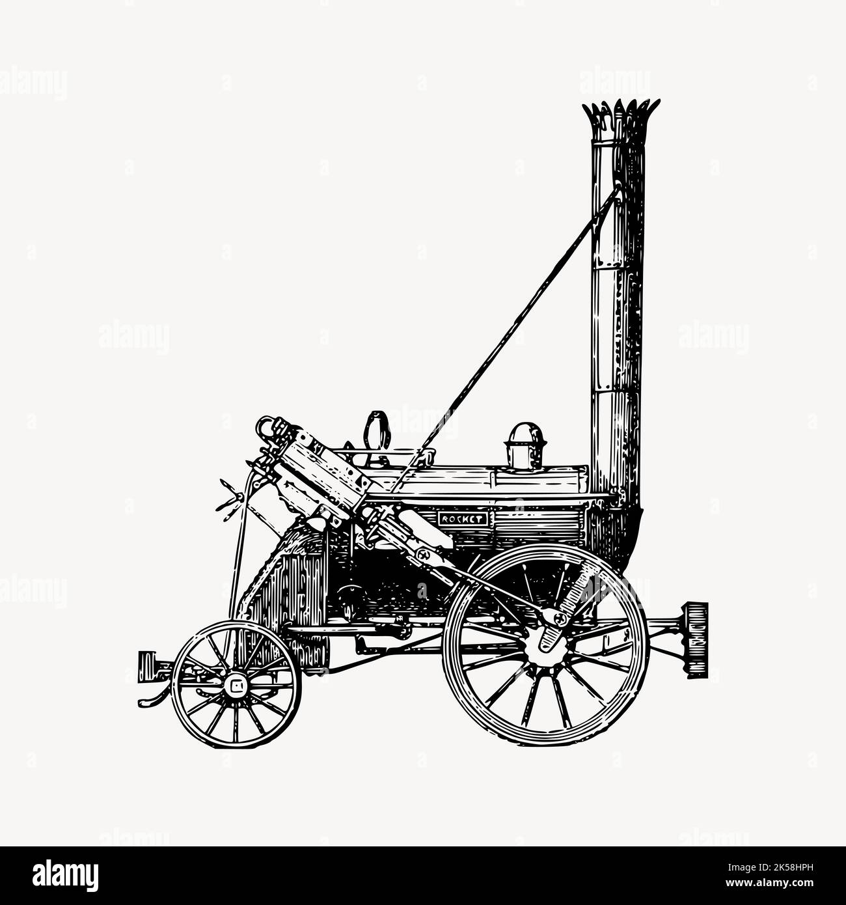
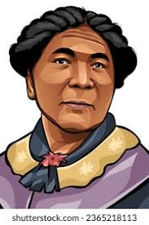
KS1 History – The Revolutionary Victorians
(Year 1 and Year 2)
The Victorians (introduction)
A Victorian Seaside
Victorian transport
Victorian toys
Florence Nightingale & Mary Seacole
Then & Now – impact of change (review)

Slide 8
KS1 History – The Revolutionary Victorians
The Victorians (introduction)
A Victorian Seaside
Victorian transport
Victorian toys
Florence Nightingale & Mary Seacole
Then & Now – impact of change (review)

Slide 9
KS1 History – The Revolutionary Victorians
The Victorians (introduction)
Victorian transport
Changes within living memory
Florence Nightingale & Mary Seacole
The lives of significant individuals in the past who have contributed to national and international achievements
Then & Now – impact of change (review)
Significant historical events, people and places in their own locality
Fire! Fire!
Events beyond living memory that are significant nationally or globally

Slide 10


KS1 History – The Revolutionary Victorians
Victorian transport
Changes within living memory
Victorian Transport

Slide 11


Surface Knowledge
Victorian transport
Changes within living memory
Find out more about transport
(horse & carriage, steam train, early bicycles). Handle images and artefacts.
Main focus: trains

Slide 12
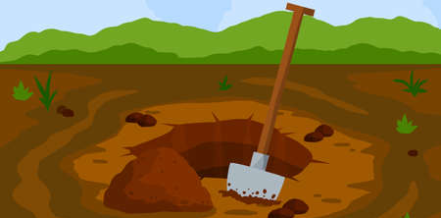
Deeper Knowledge
Victorian transport
Changes within living memory
Compare past and present transport. Discuss and explain how technology improved travel.
Main focus: trains

Slide 13
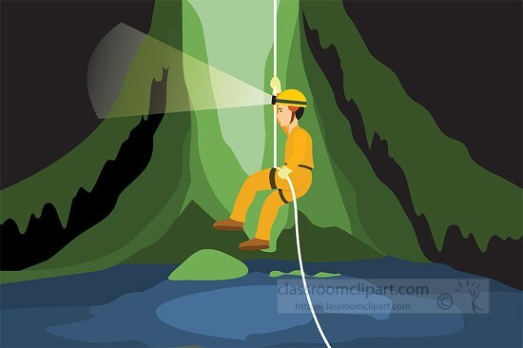


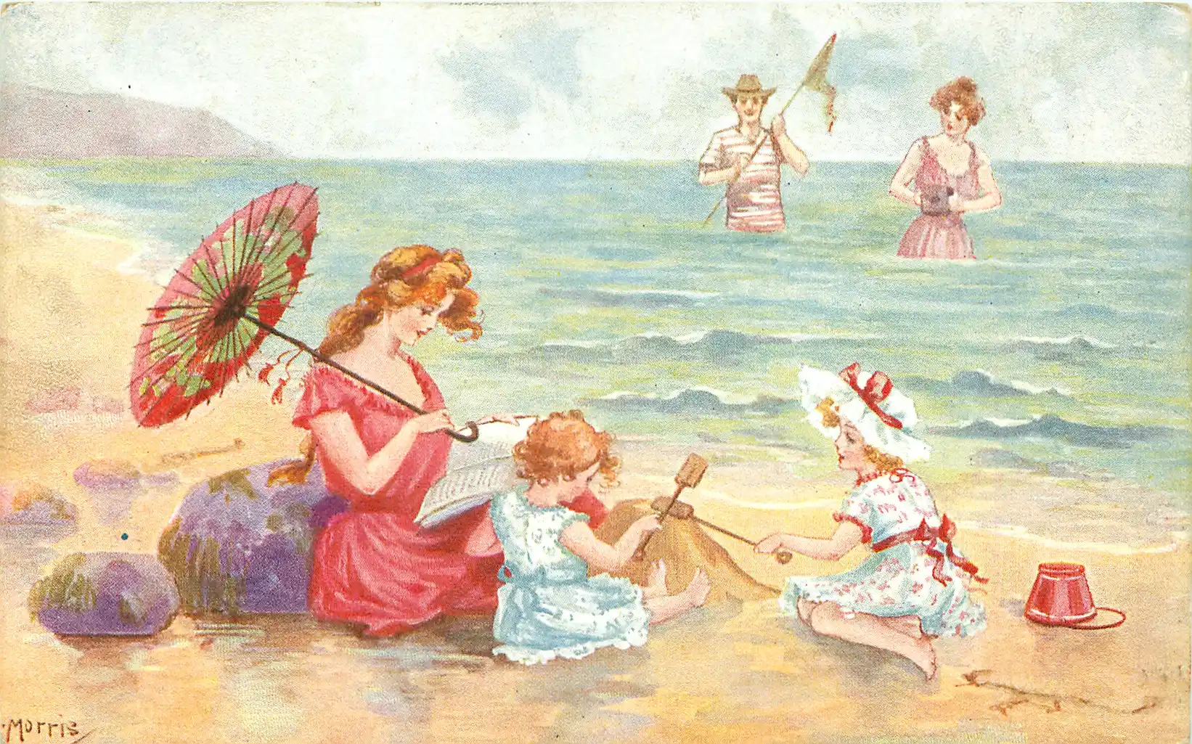
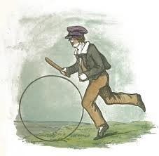
Adventurer Knowledge
Victorian transport
Changes within living memory
Investigate cause and effect: How did steam power change industry, travel and leisure? What further advances have been made? What would life be like now if technology hadn’t improved?
Main focus: trains

Slide 14






Cross Curricular Links
Victorian transport
Changes within living memory
Suitability of materials
Captions
Explanation texts
Describe and compare
Designing and testing structures
Measuring
Locality study
OS map symbols

Slide 15
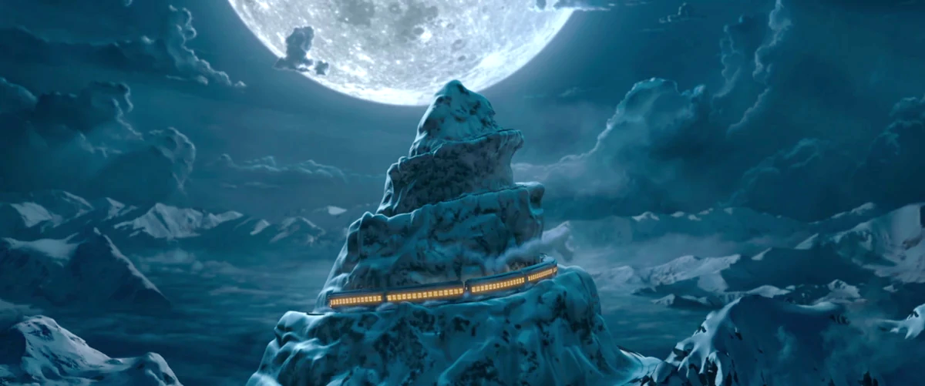

GTS Spiral Curriculum
Imagine your child’s learning journey like the Polar Express making its way up a snowy mountain. The train doesn’t rush straight to the top — instead, it circles the mountain, climbing a little higher with each turn. Every time it comes around again, it’s at a higher level, stronger, and better equipped for the journey ahead.
Carefully planned curriculum progression

Slide 16
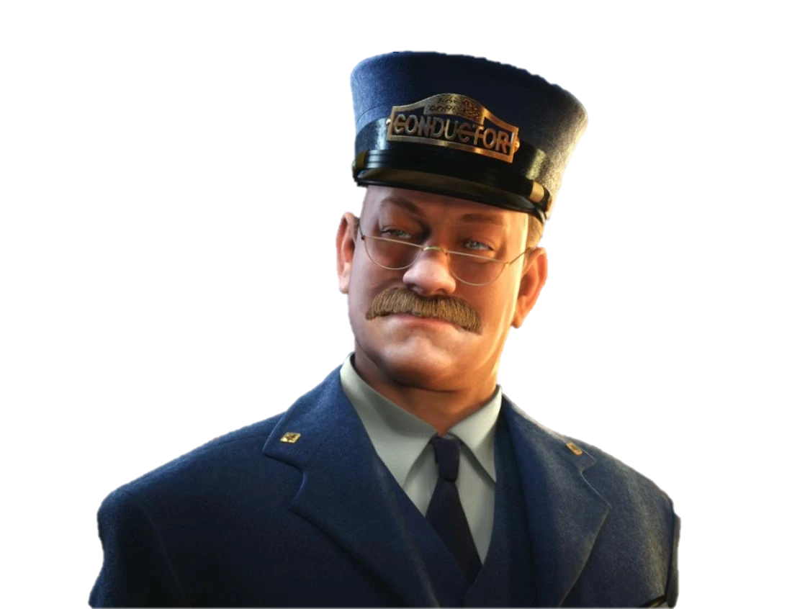
GTS Spiral Curriculum
The star at the top of the mountain -Deep understanding, mastery, and readiness for the next stage of learning
The same landscape looks different from above — wider, clearer, more connected - Seeing how learning links together across subjects and years
Each time the train circles, it collects more luggage — new ideas, understanding, skills and knowledge - Knowledge and understanding that builds over two years
Revisiting familiar scenery from a higher view - Returning to key knowledge and skills at a deeper level
Learning matches the stage of development your child is at…if areas of learning need consolidating, then this builds strong foundations.
Your child’s learning journey

Slide 17

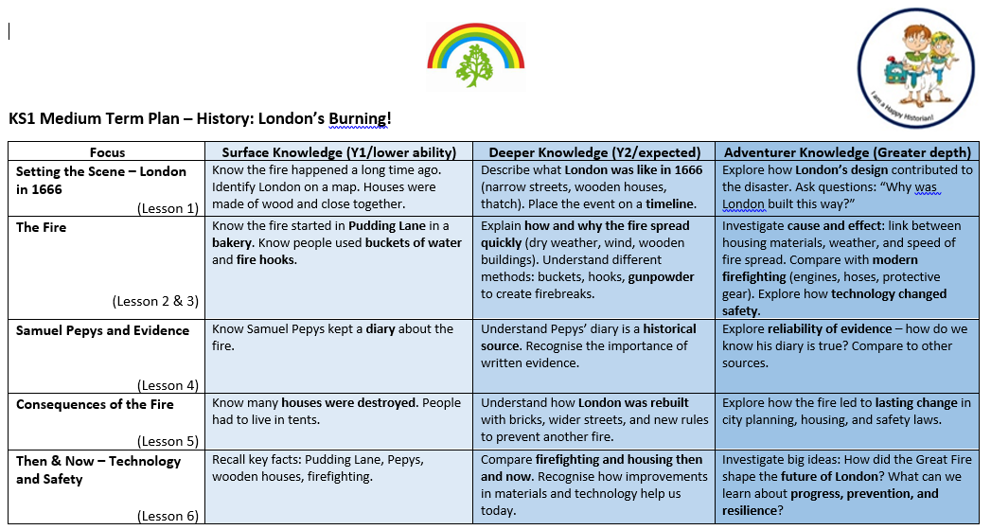

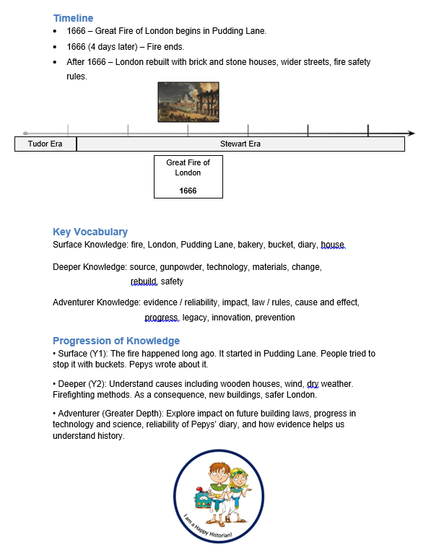

Work in progress…
Medium Term Planning
Knowledge Organiser

Slide 18
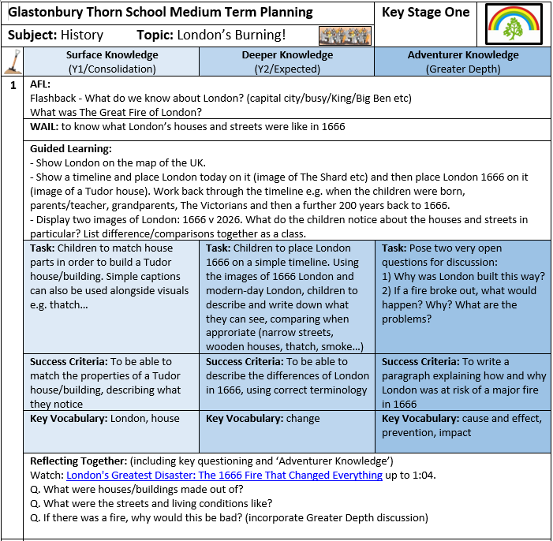
Bringing learning to life!

Slide 19
Thank you for listening

