Slide 2

Symbol of Sikhism

Slide 3
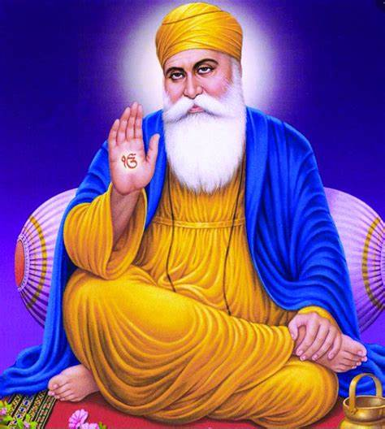
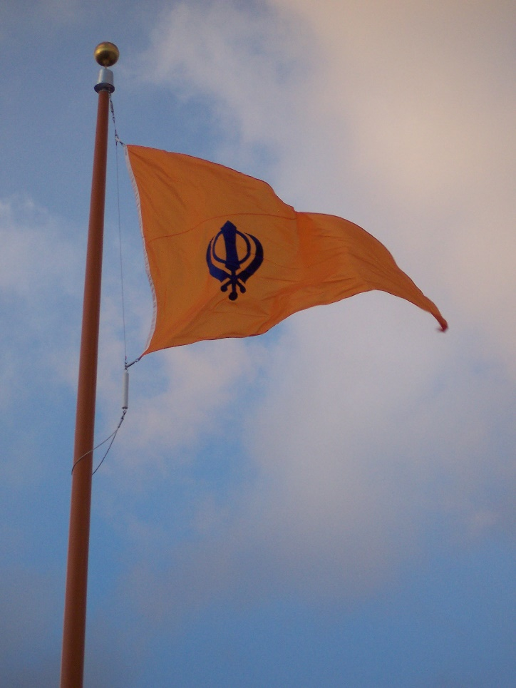
Sikhism was founded by Guru Nanak around 500 years ago in a place called the Punjab. This is an area which spans part of India and Pakistan in South Asia today.
What do Sikhs believe?
Sikhs believe in one God who guides and protects them. They believe everyone is equal before God. They believe the way to do this is:
Keep God in your heart and mind at all times
Live honestly and work hard
Treat everyone equally
Be generous to those less fortunate than you
Serve others

Slide 4
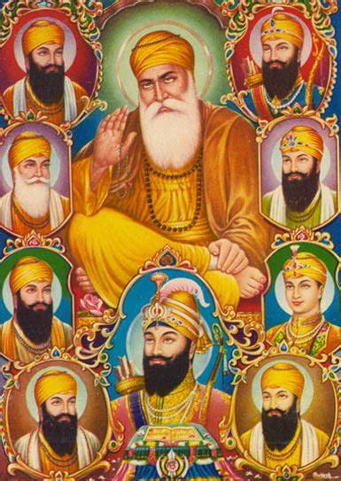
Sikhs believe in 10 Guru’s

Slide 5

What are the 5Ks?
Punj Kakkars (5 Ks)
This is their names and what they are
3) Kara
Iron bangle
2) Kanga
Wooden comb
4) Kirpan
Small sword
1) Kes
5) Kachera
Uncut hair
Cotton shorts

Slide 6

Kesh is uncut hair kept natural the way God wanted it to be and not cut, permed, coloured or trimmed in any way!

Slide 7

What do Sikhs Believe?
Kangha
This is a small comb worn in a Sikh’s hair.

Slide 8
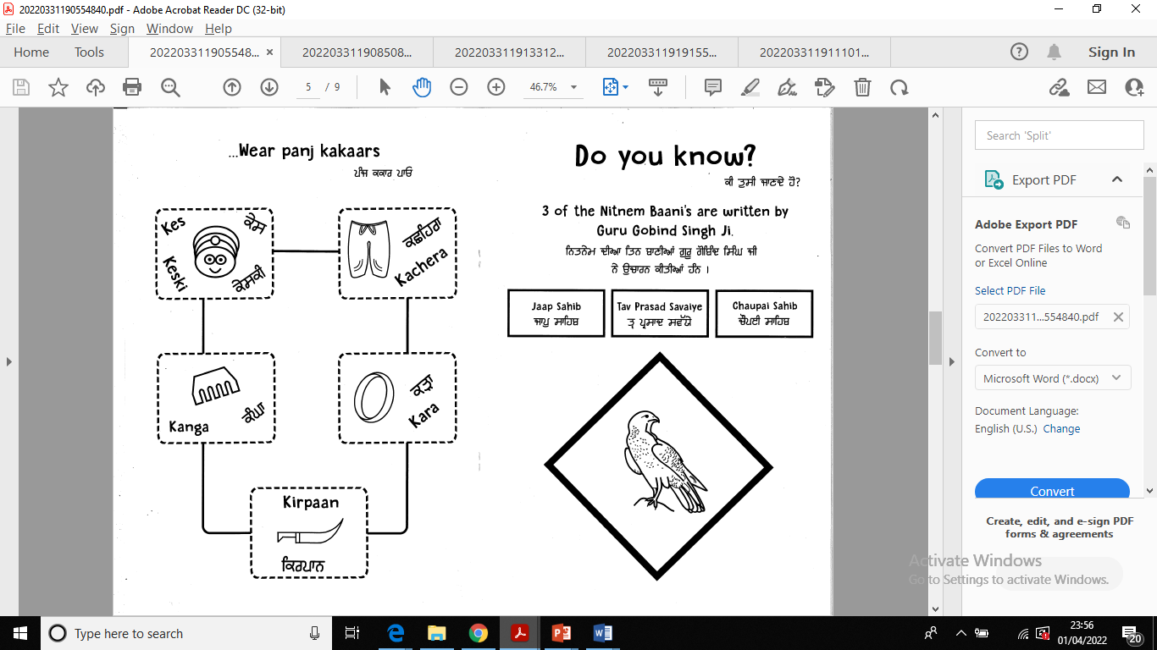
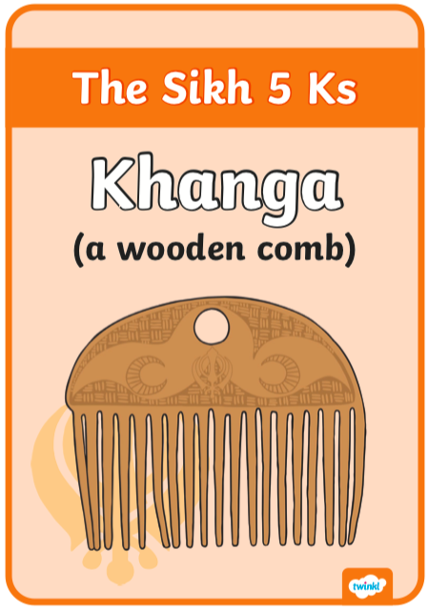
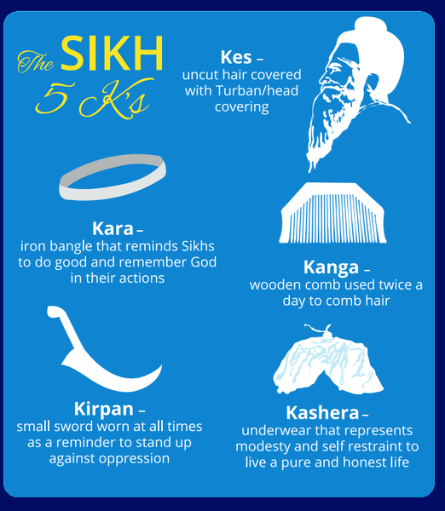
Why wear a kanga?
It is supposed to be kept in the Kes at all times.
Kanga helps to keep the Kes neat and tidy.
Kanga helps to comb out bad thoughts.

Slide 9


What do Sikhs Believe?
Kara
Sikhs wear a bangle to show they belong to the Sikh faith.

Slide 10

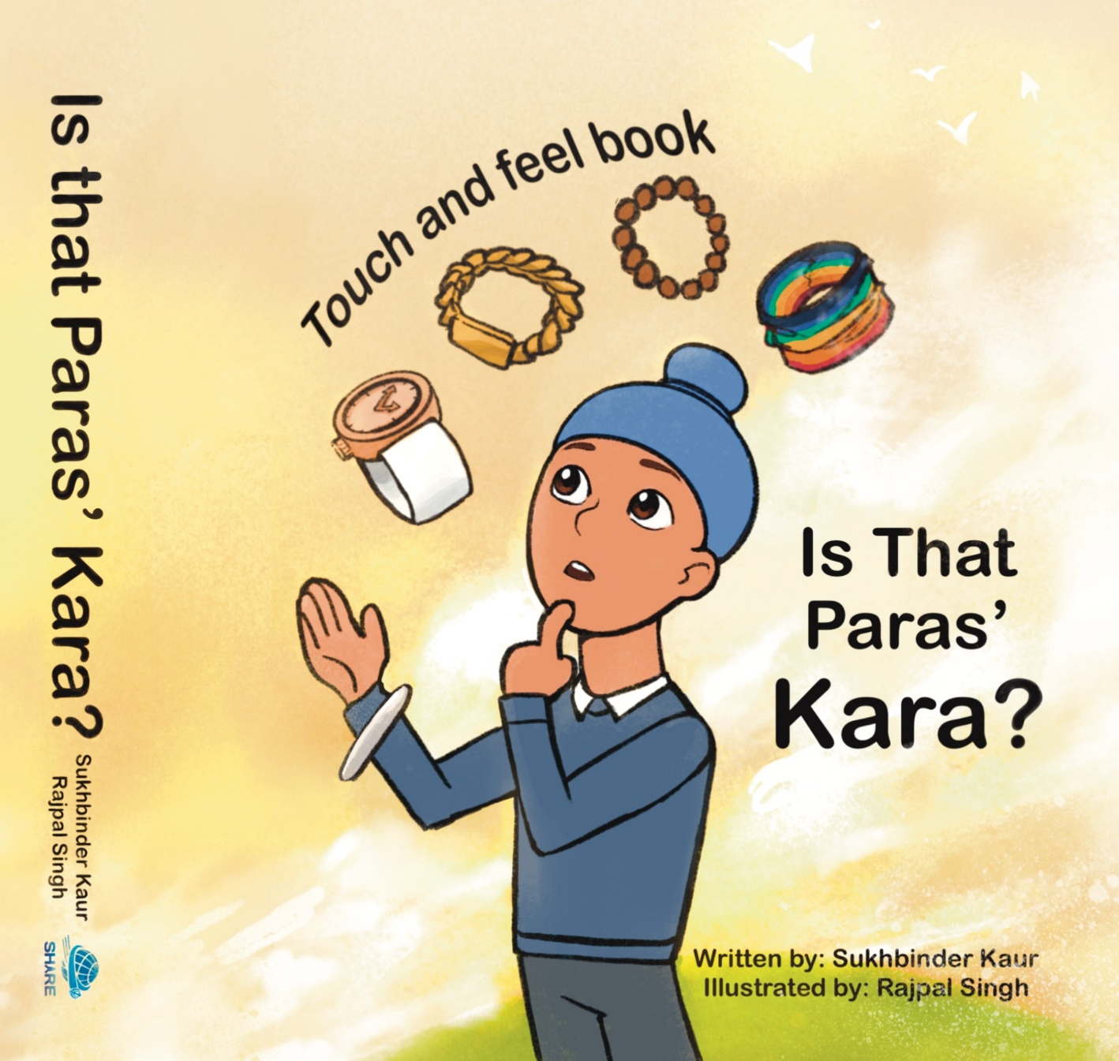
There is a new book out about
the Kara
Can you show me your kara?

Slide 11
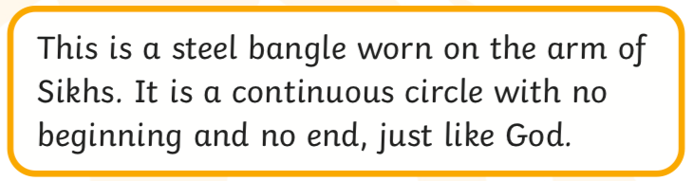


Why wear a kara?
iron

Slide 12


What do Sikhs Believe?
Kirpan
Sikhs wear this over or under their clothes to show that all Sikhs protect each other.

Slide 13
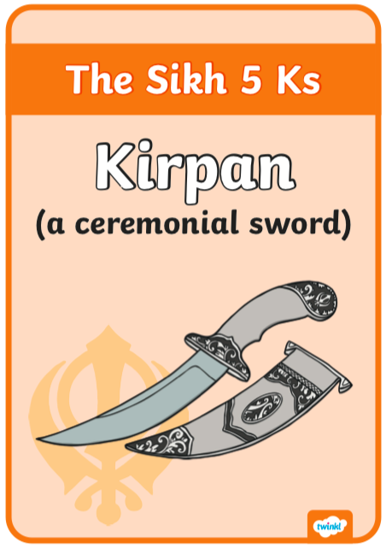
It represents protecting others and keeping them safe.

Slide 14
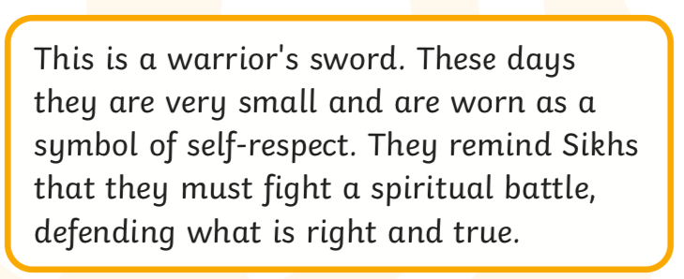
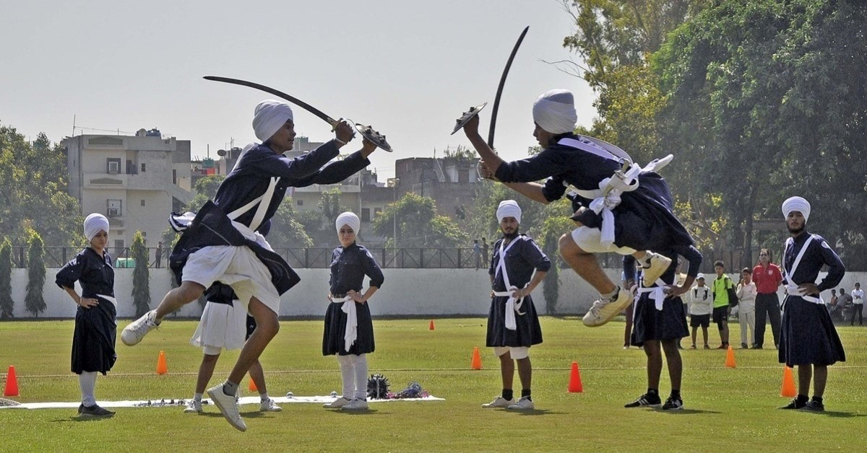
Why wear a kirpan?

Slide 15


What do Sikhs Believe?
Kachera
This is a white, cotton undergarment worn to show their Sikh faith.

Slide 16


Slide 17
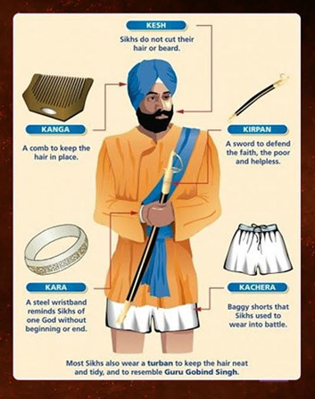
The 5 Ks are like the uniform for Sikhs to wear at all times to be recognised wherever they go

Slide 18
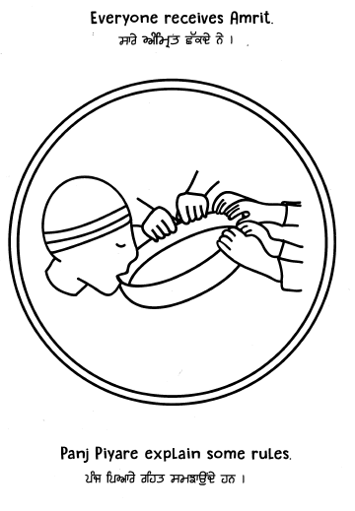
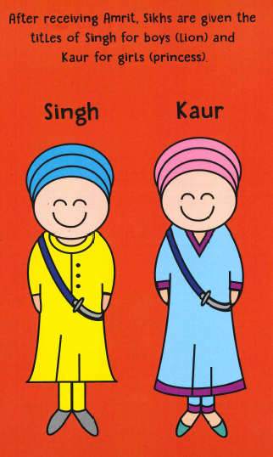
Who can wear the 5Ks?
who

Slide 19
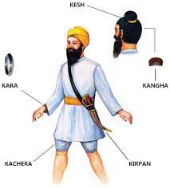
How to wear the 5K’s?

Slide 20
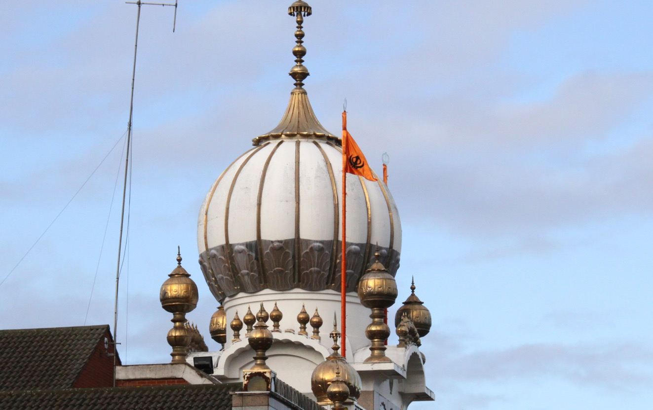

Nishan Sahib flag
‘Guru Nanak Gurdwara Smethwick 1’ by Tony Hisgett is licensed under CC BY 2.0 (cropped from the original)

Slide 21
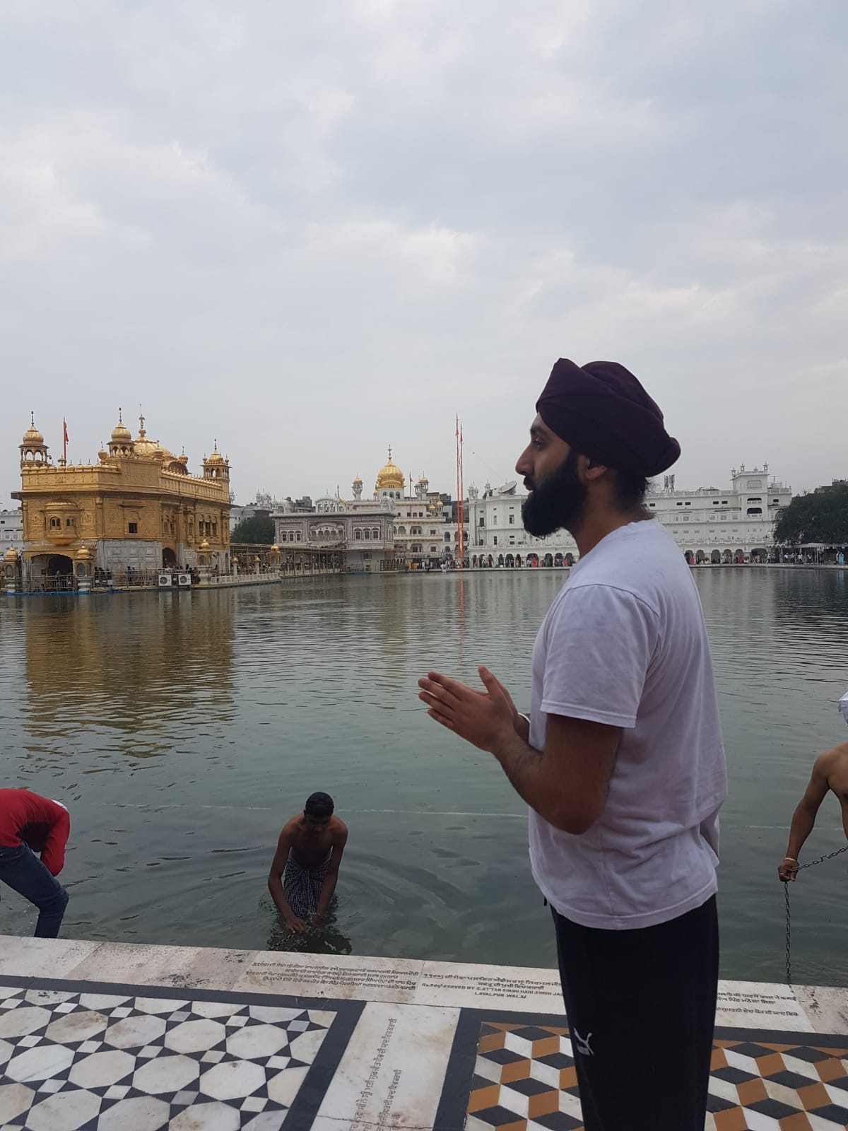
Golden Temple
‘Guru Nanak Gurdwara Smethwick 1’ by Tony Hisgett is licensed under CC BY 2.0 (cropped from the original)

Slide 23
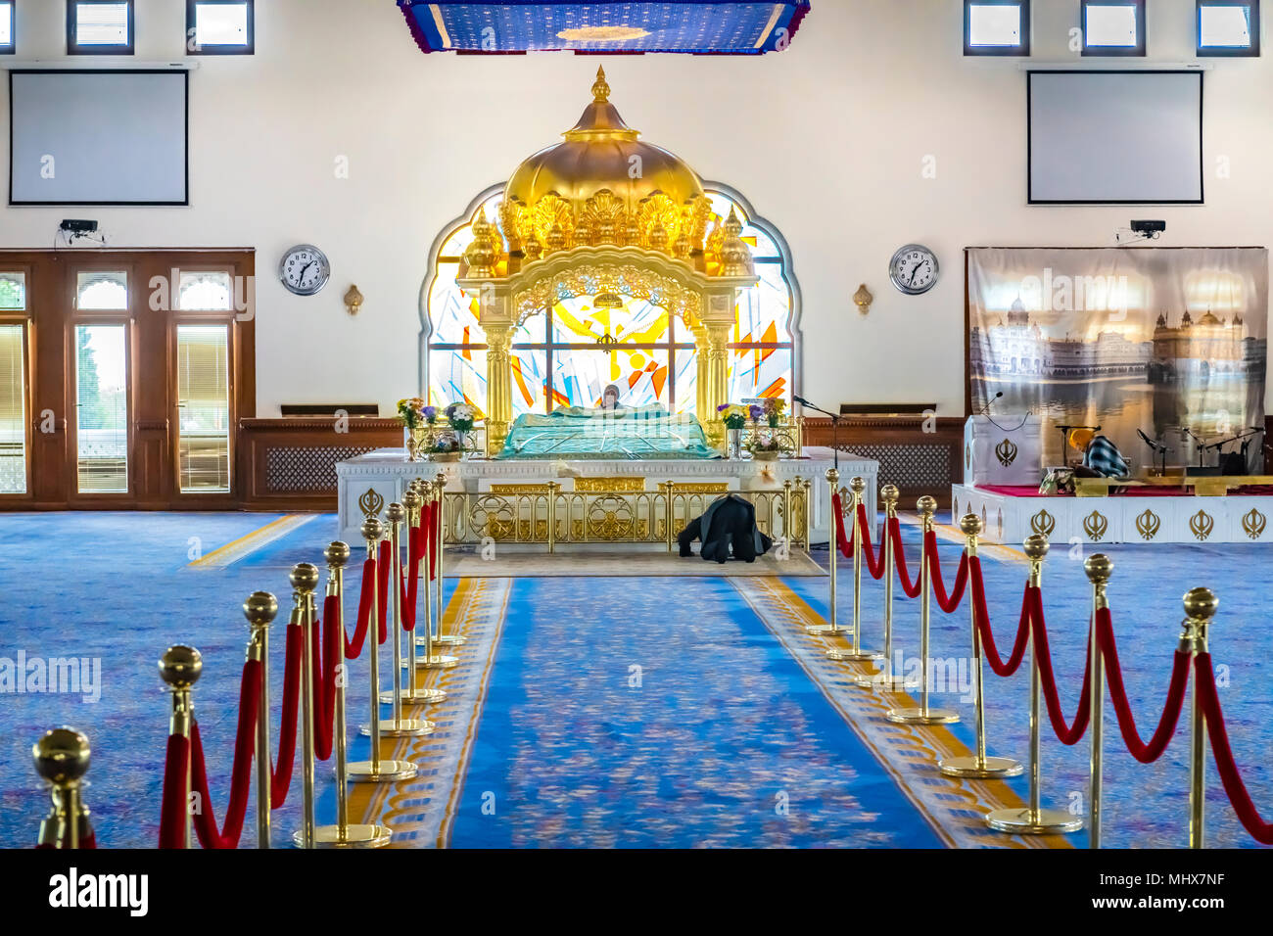
Inside a Sikh temple- Gudwara
‘Punjab Cultural Heritage Day -040’ by sasastro is licensed under CC BY 2.0 (cropped from the original)

Slide 24
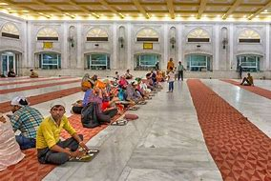
Langar hall- Dinning hall
‘Delhi, commemoration of the Martyrdom of Guru Tegh Bahadur’ by Arian Zwegers is licensed under CC BY 2.0 (cropped from the original)

Slide 25
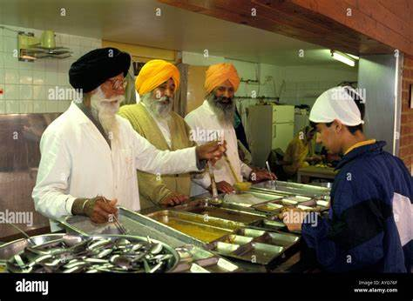
Serving food
‘Punjab Cultural Heritage Day -029’ by sasastro is licensed under CC BY 2.0 (cropped from the original)

Slide 26


