Slide 1
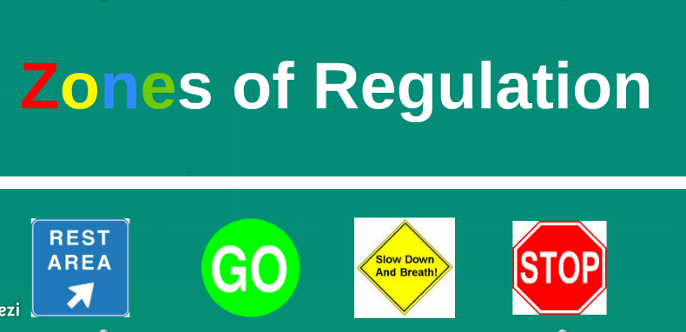

Slide 2

ZONES OF REGULATION SONG
https://www.youtube.com/watch?v=wIRVklZXicM

Slide 3
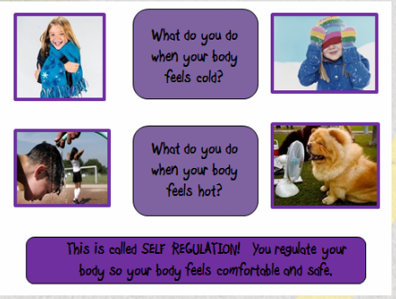
What is self-regulation?
The ability to focus your attention, control your emotions and manage your thinking, behaviour and feelings.

Slide 4
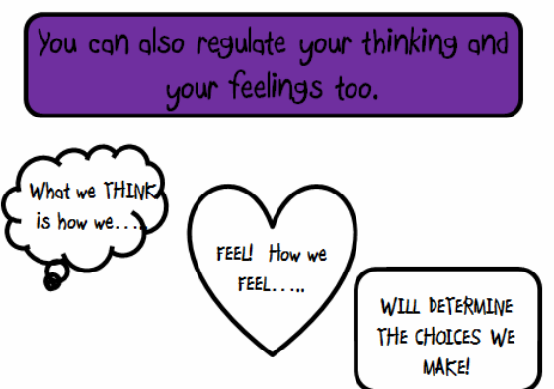

Slide 5
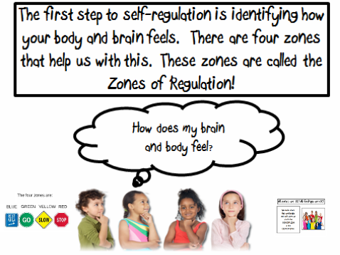

Slide 6
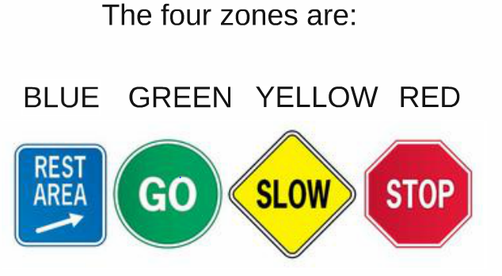

Slide 7
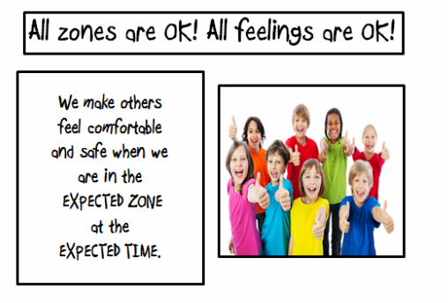

Slide 8

Our Zone is determined by how we feel on the inside NOT our outward behaviour

Slide 9
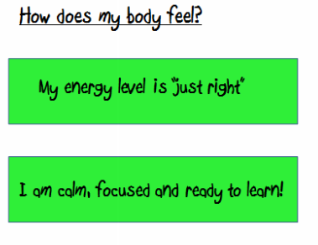

The Green zone…..the learning zone!!
We are expected to be in the Green Zone while we are learning. It is when our brains and bodies are relaxed and focused!

Slide 10
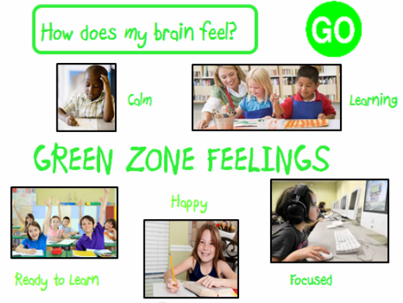

Slide 11
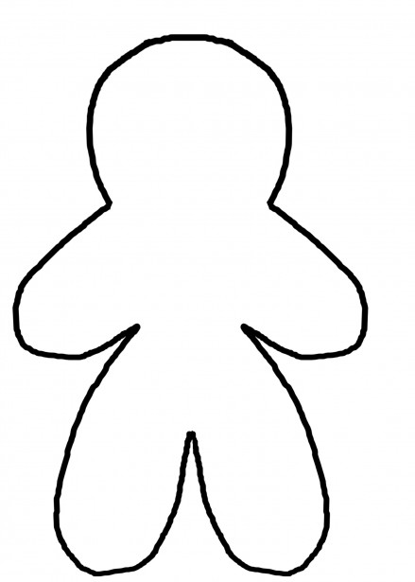
Green Zone
Possible body signals
Focused and engaged brain
Steady heartbeat
Comfortable body temperature
Relaxed muscles

Slide 12
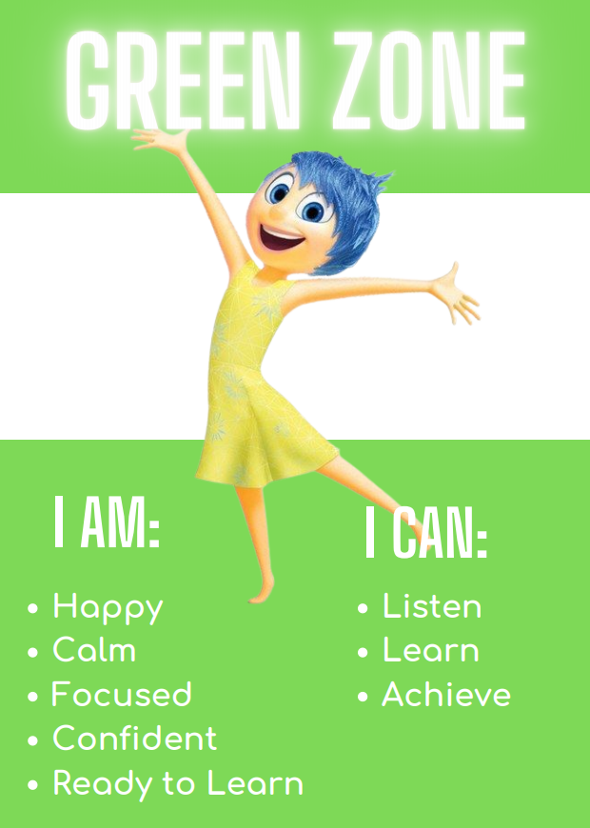
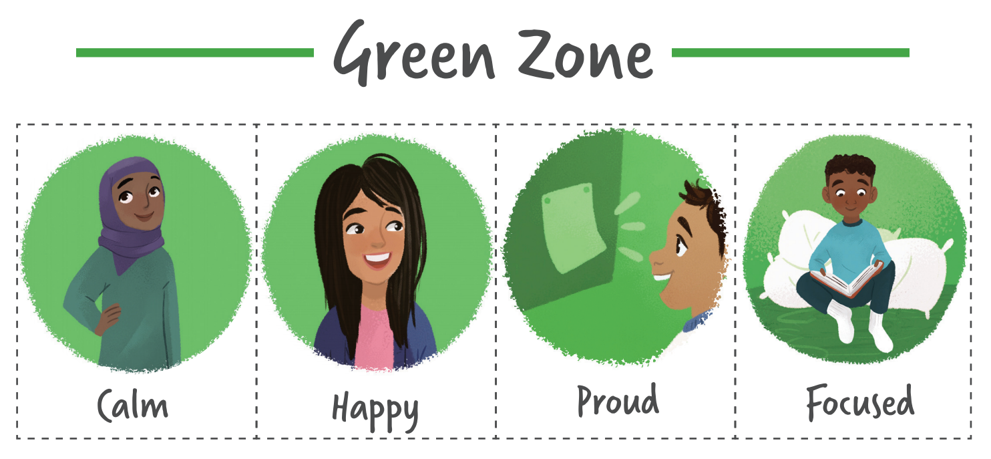

The Green Zone, like a green light, is when you are “good to go.” If you are in the Green Zone, you may feel happy, calm, and focused.

Slide 13
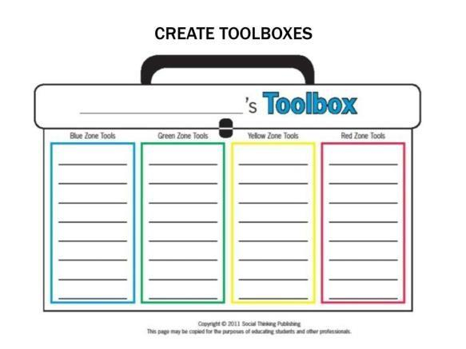
UNDERSTANDING ZONE TOOLS
Green Zone tools: help us stay calm, focused and feeling good.
These are often proactive strategies.

Slide 14
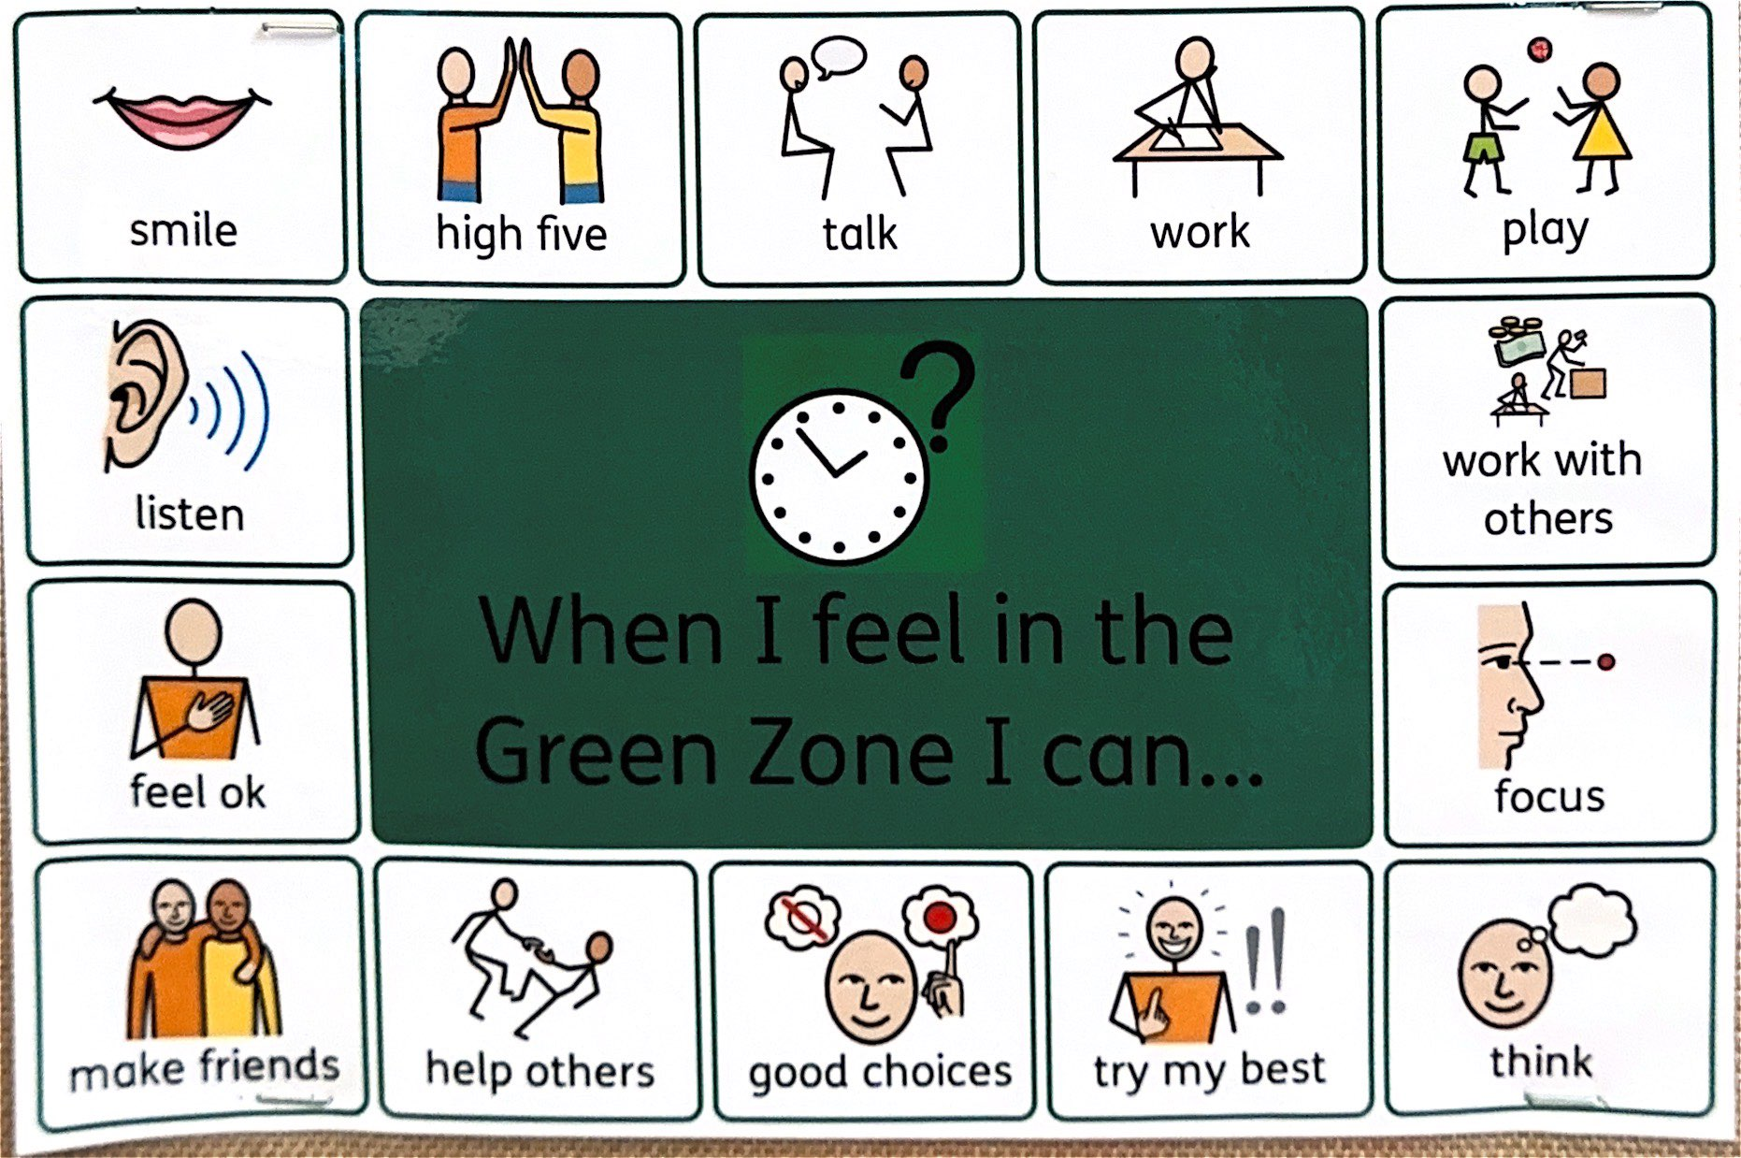

Slide 15
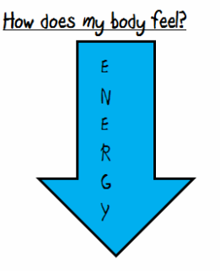

The Blue Zone
We are expected to be in the Blue Zone just before bedtime or when we are watching the TV. We are running slow! We might be tired or sad. This is an unexpected zone to be in for learning.

Slide 16
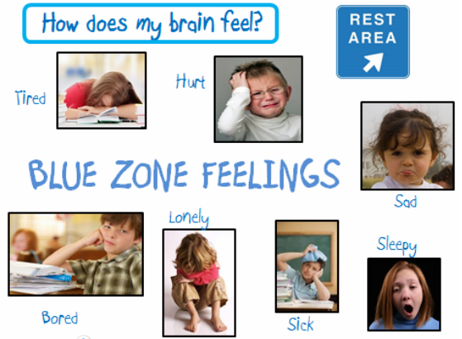

Slide 17
Blue Zone
Possible body signals
Low energy
Foggy head
Feeling ill
Slow heartbeat
Heavy limbs
Moving slowly

Slide 18
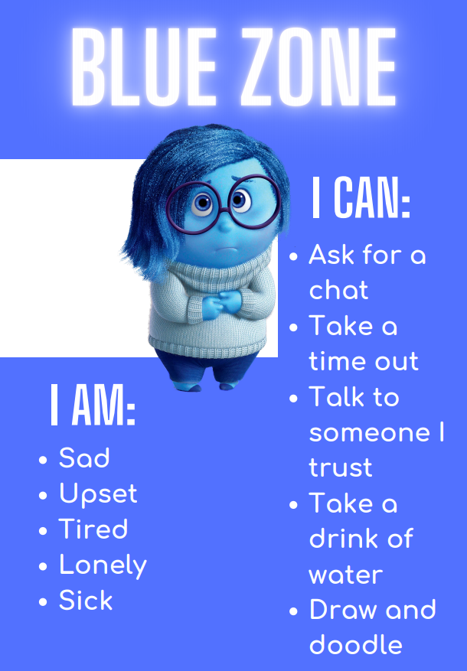
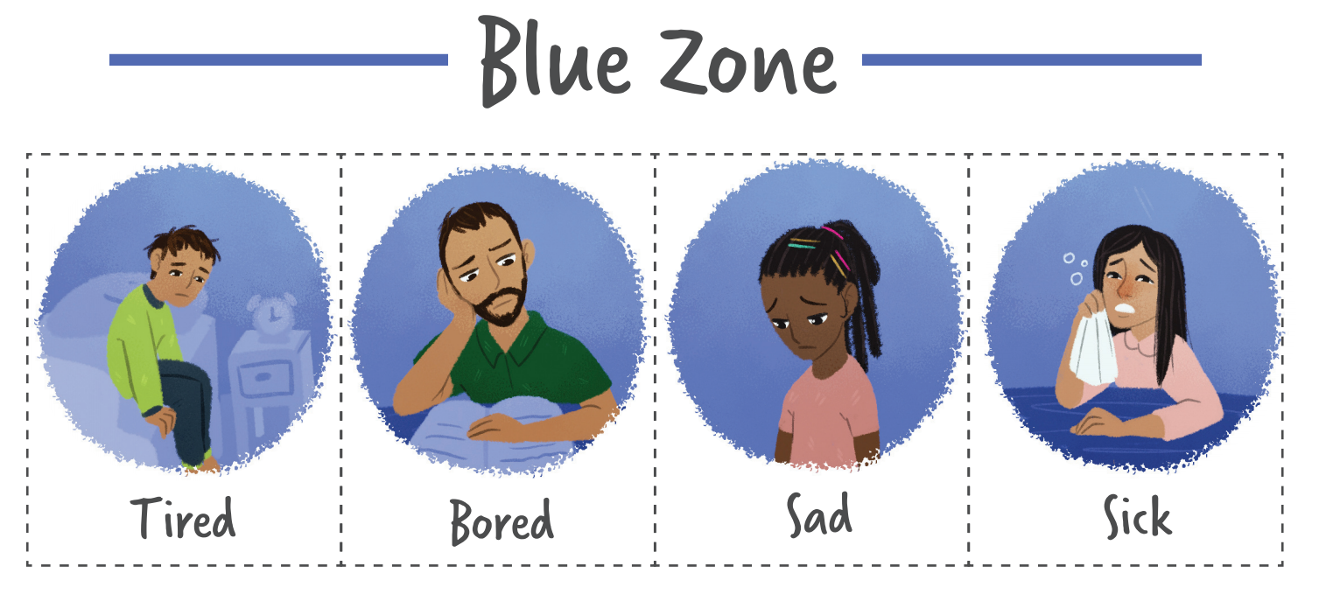
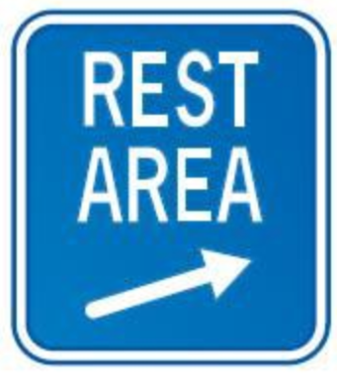
When you’re in the Blue Zone, your body is
running slow, such as when you are tired, sick,
sad or bored

Slide 19
UNDERSTANDING ZONE TOOLS
Blue Zone tools: help wake up our bodies, feel better and regain focus.

Slide 20
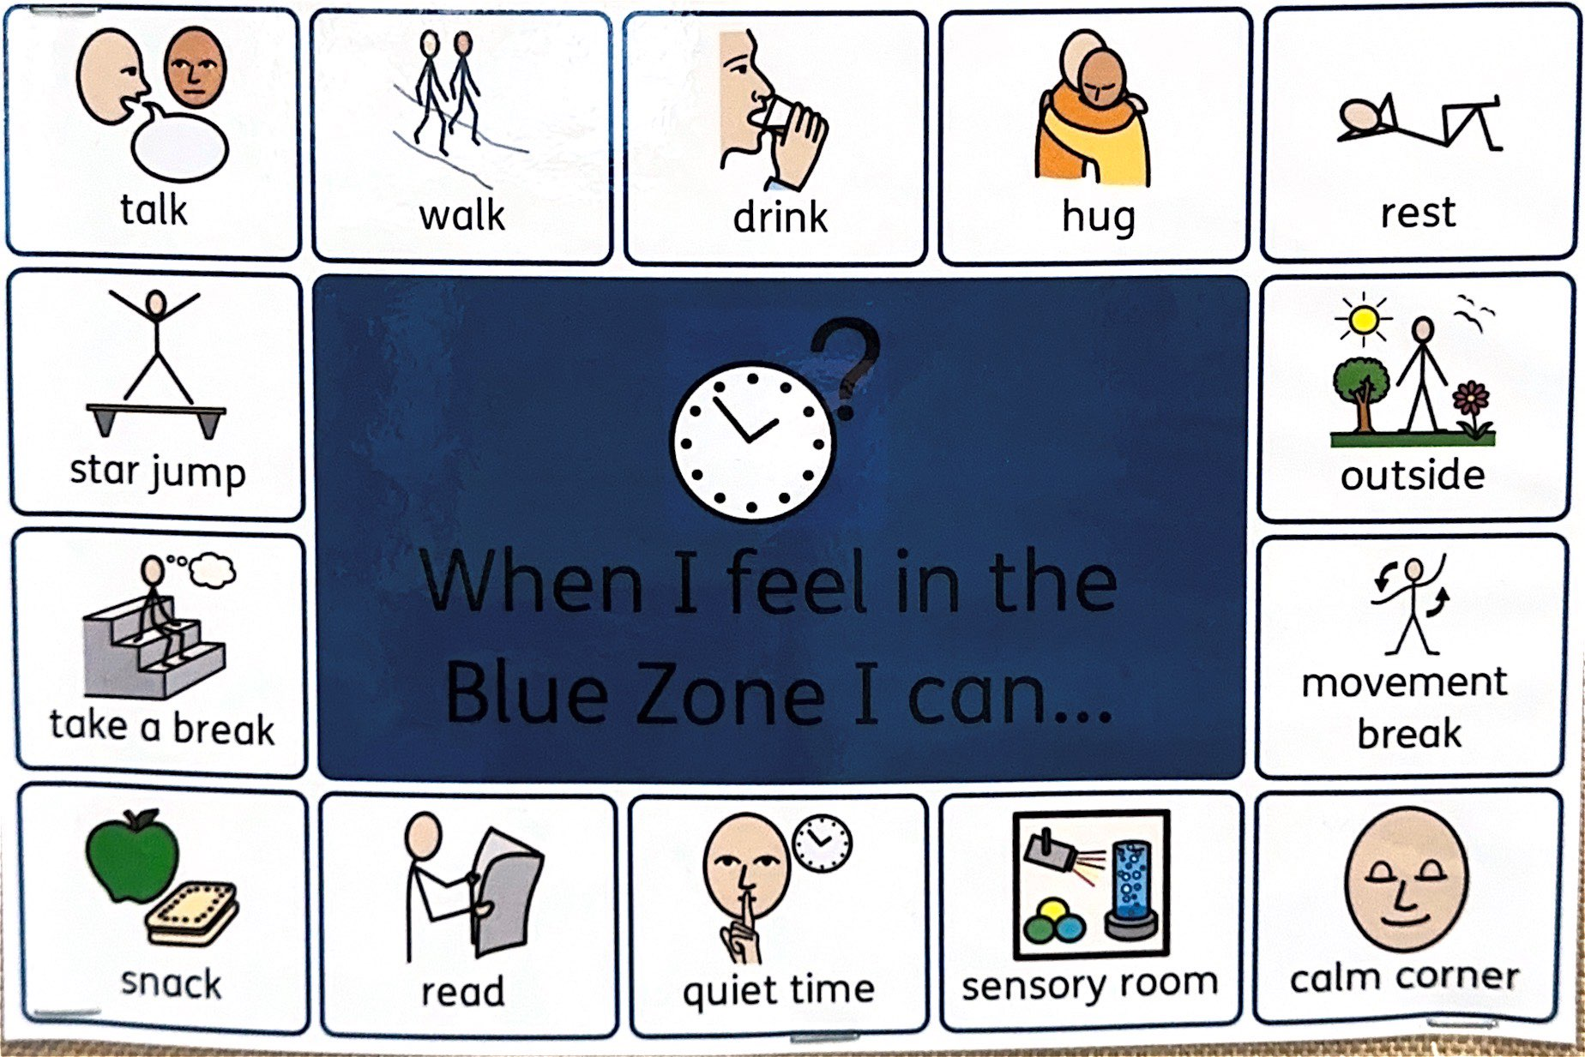

Slide 21
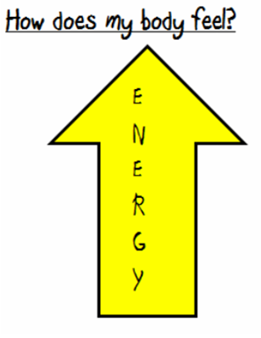
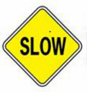
The Yellow Zone……during play time, lunch time and even at the end of the day, it’s expected for us to be in the YELLOW ZONE!!

Slide 22
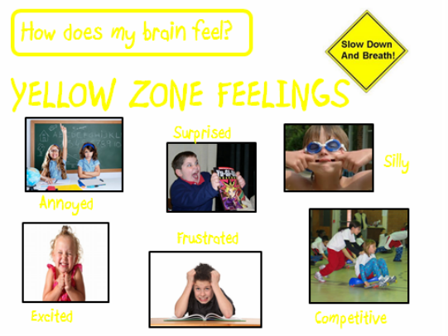

Slide 23
Yellow Zone
Possible Body signals
Thinking faster
Heart beating
faster
Raised voice
Fidgety
Body warming up
Lack of focus
Muscles tense

Slide 24
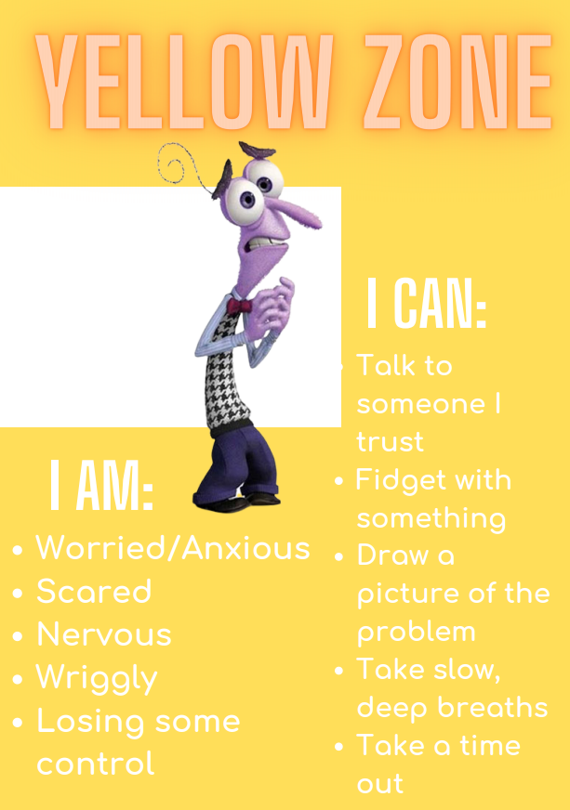
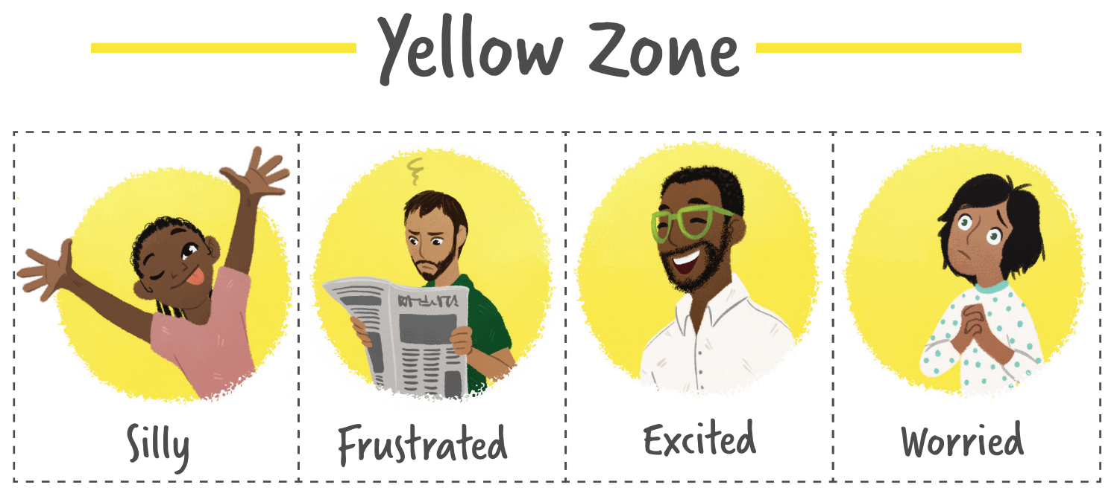
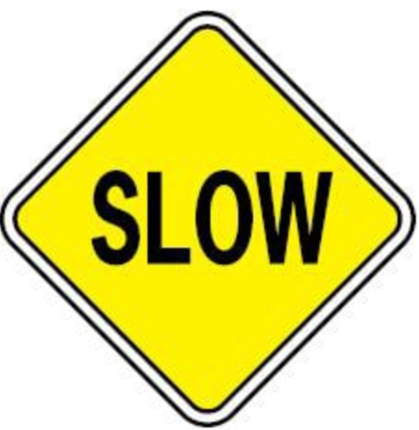
The yellow zone describes when you start to lose control, such as when you are frustrated, overwhelmed, silly, wiggly, excited, worried, anxious or surprised. It is a good idea to use caution when you are in the yellow zone.

Slide 25
UNDERSTANDING ZONE TOOLS
Yellow Zone tools: help us regain control and calm ourselves.

Slide 26
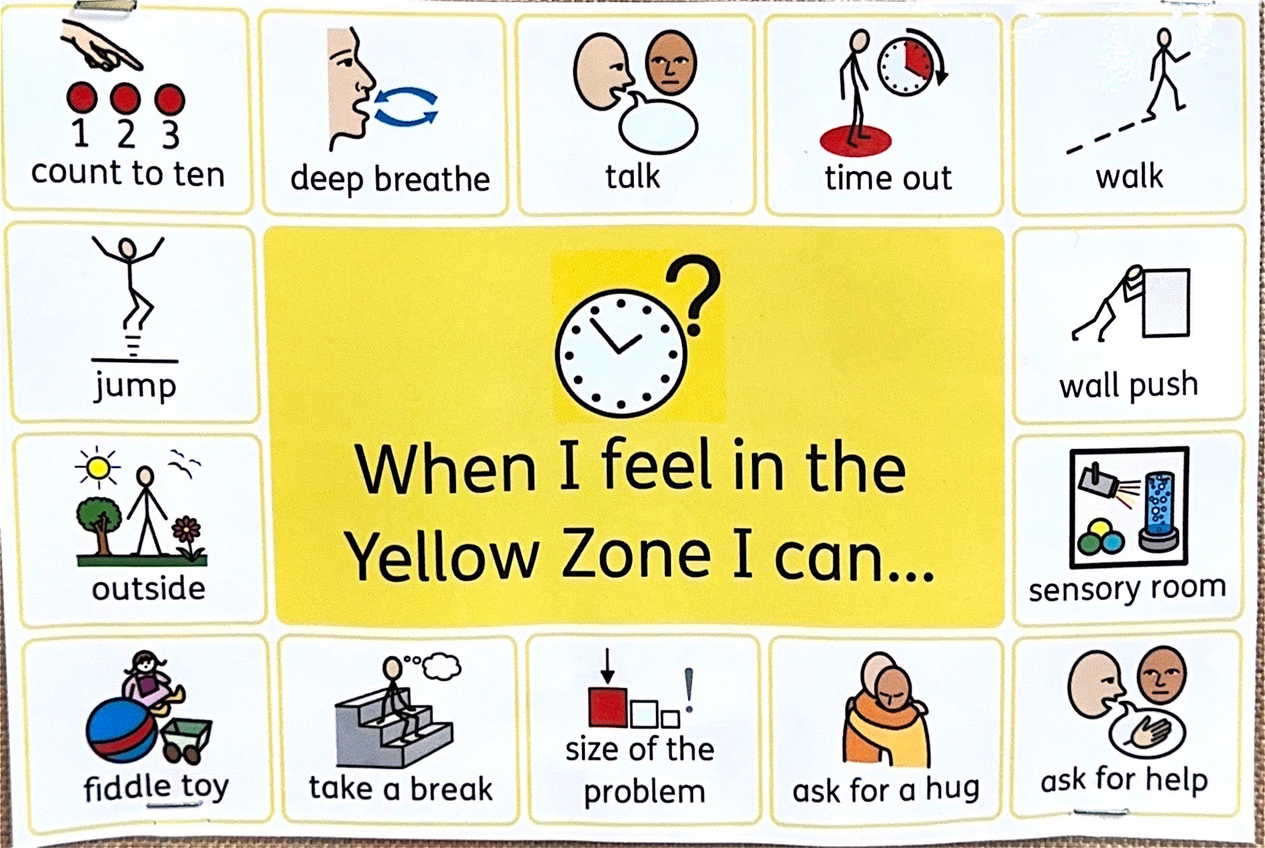

Slide 27
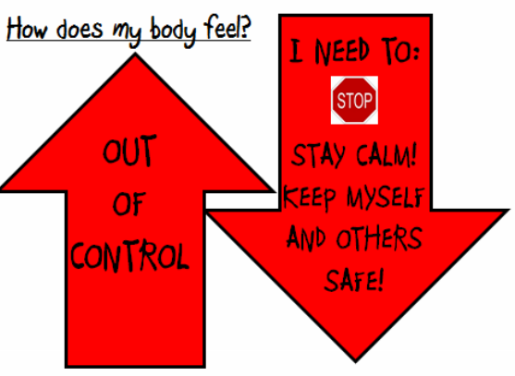

The Red Zone….when we are at school, the Red zone is not expected! We must keep ourselves and others safe!

Slide 28
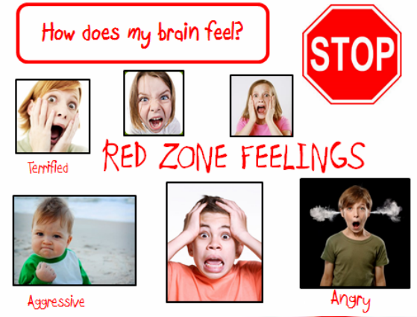

Slide 29
Red Zone
Possible Body Signals
Heartbeat fast
Hot/sweating
Louder voice
High energy
Skin flushed
Muscles tense

Slide 30
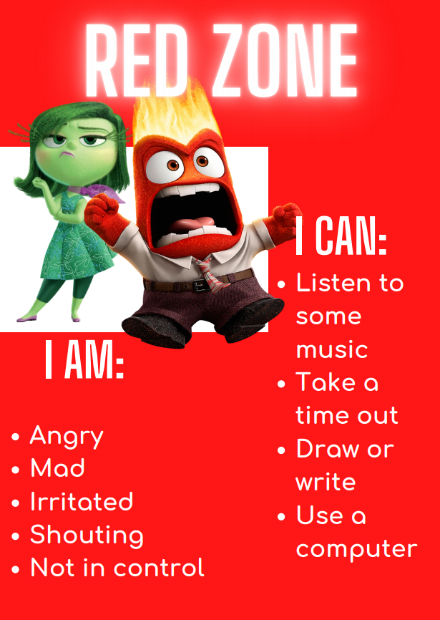
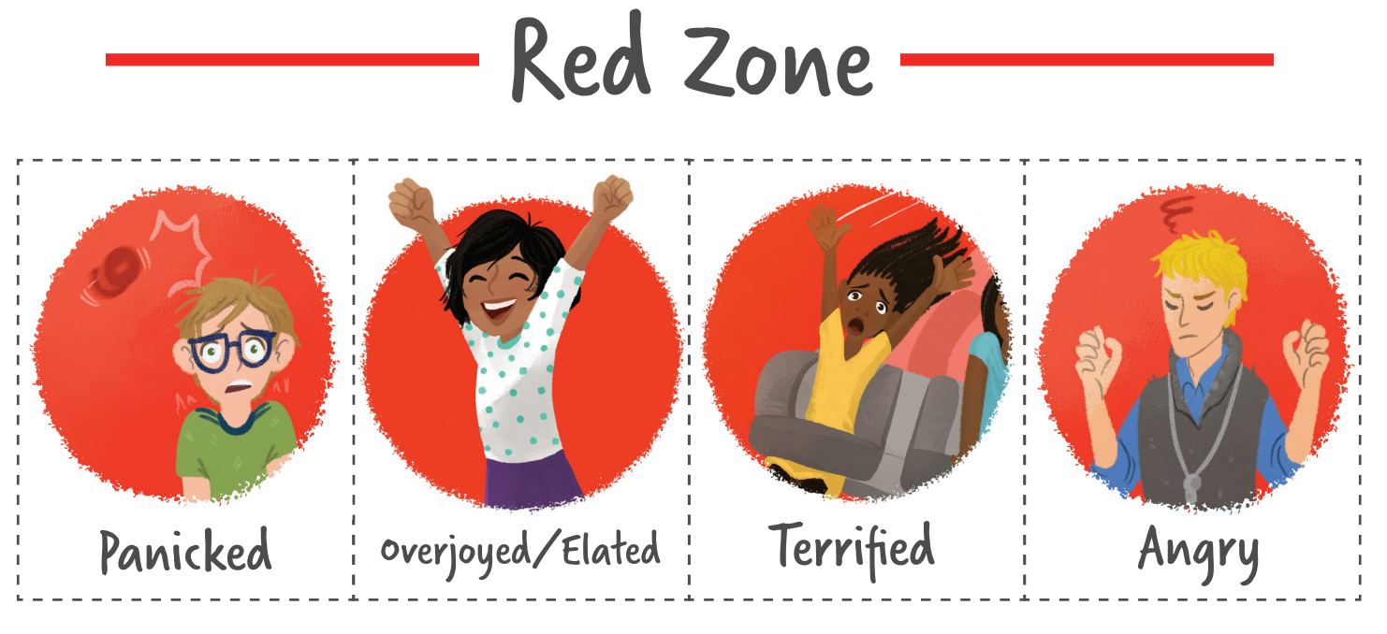

The red zone is reserved for extreme emotions like terror, uncontrolled anger, and aggression. When you are in the Red Zone, you are out of
control, have trouble making good decisions, and must STOP to regulate.

Slide 31
UNDERSTANDING ZONE TOOLS
Red Zone tools: help us stay safe and start to calm down.

Slide 32


