Slide 1


Slide 2






Slide 3
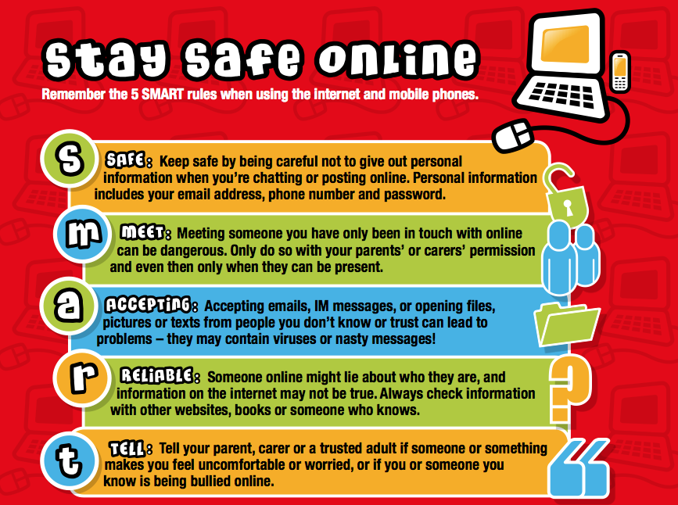

Slide 4
Social Media
- Any information you post online can be copied, altered and reposted by anyone
Posting inappropriate, offensive or illegal content can get you into trouble with friends, family and even the Police

Slide 5
Social Media
You have to be 13 years old to have a Facebook, Instagram, TikTok and Snapchat account
Only have friends that you trust OFFLINE on your social media – not everybody is who they say they are

Slide 6
Security Settings
FACEBOOK: Ensure you have privacy settings to FRIENDS ONLY
INSTAGRAM: Make sure your account is PRIVATE and only accept follow requests from people you know and trust in person
SNAPCHAT: Do not add or accept people that you do not know and trust in person
TIKTOK: Make sure your account is PRIVATE and only accept follow requests from people you know and trust in person

Slide 7
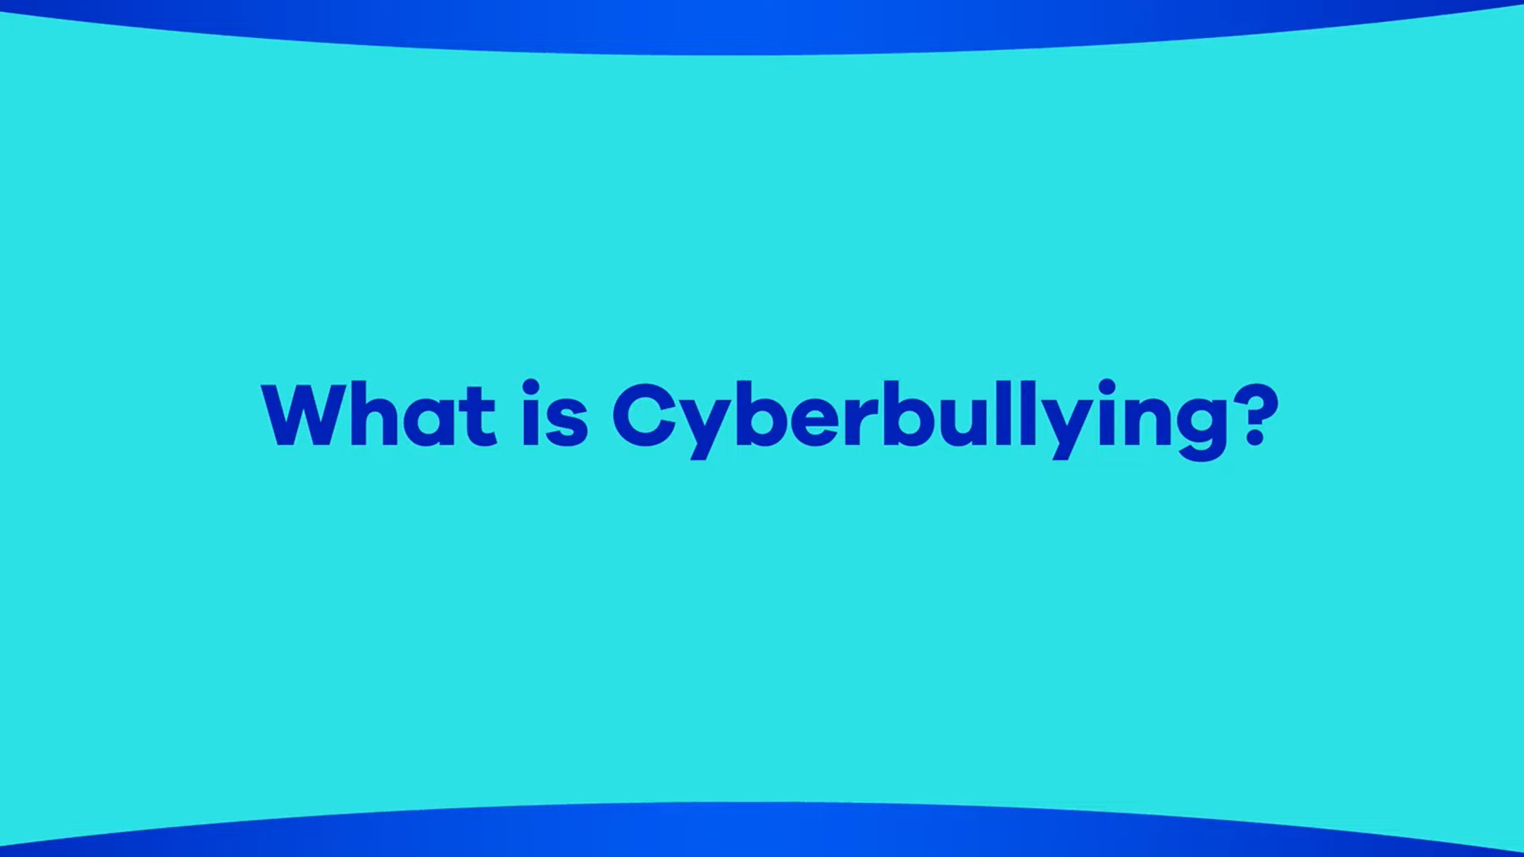

Slide 8
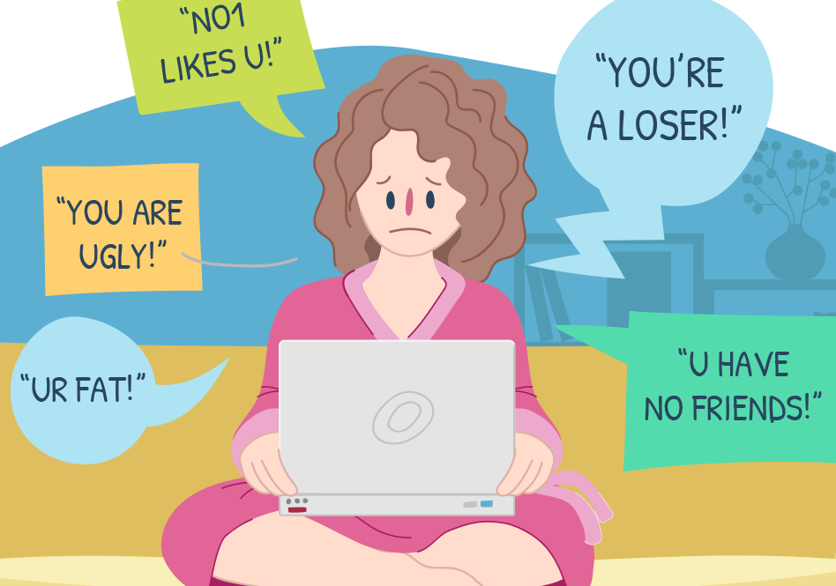
Consequences – Victim
Low self-esteem/confidence
Negative emotional responses
Problems at school
Becoming quiet and reserved
Lack of social skills

Slide 9

Consequences – Perpetrator
Cyberbullying is very serious and perpetrators can be dealt with by the Police:
  Protection from Harassment Act 1997
  Malicious Communications Act 1988

Slide 10


