Slide 1





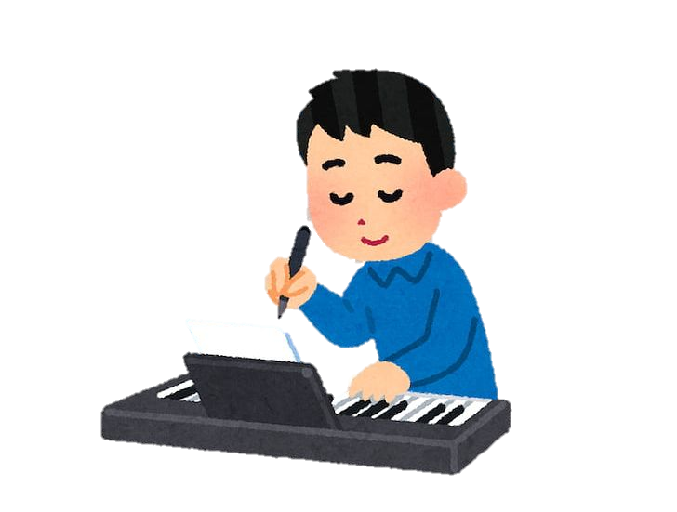
In MUSIC:
We explore different types of music!
We understand that our voice is an instrument and instruments make unique sounds!
We love to compose music and express ourselves!

