Slide 1

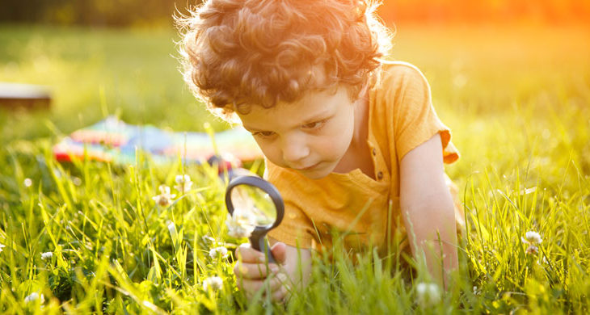
Science SPLAT
Friday 10th March 2023

Slide 2
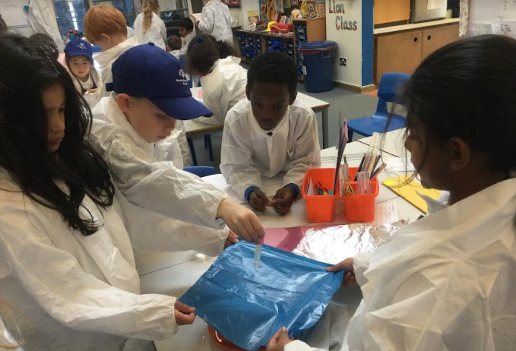
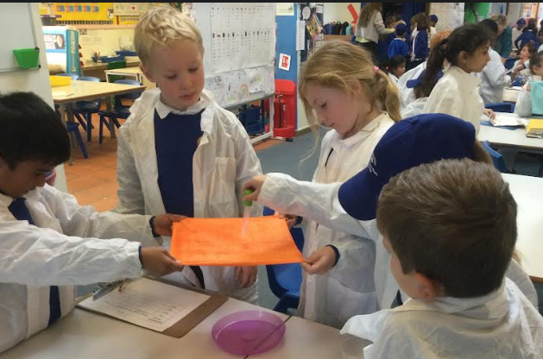
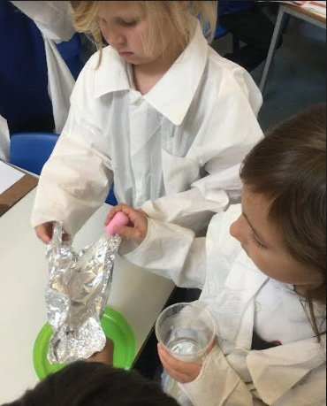
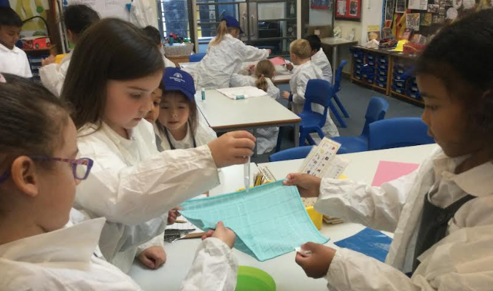
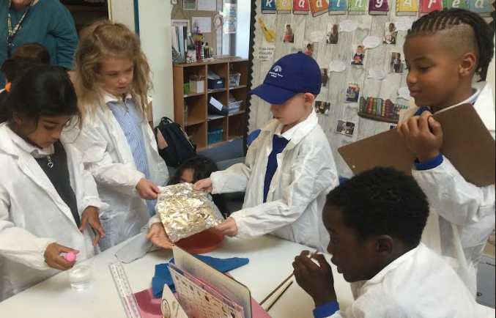
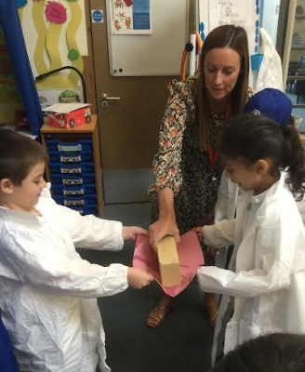
We are scientists!

Slide 3
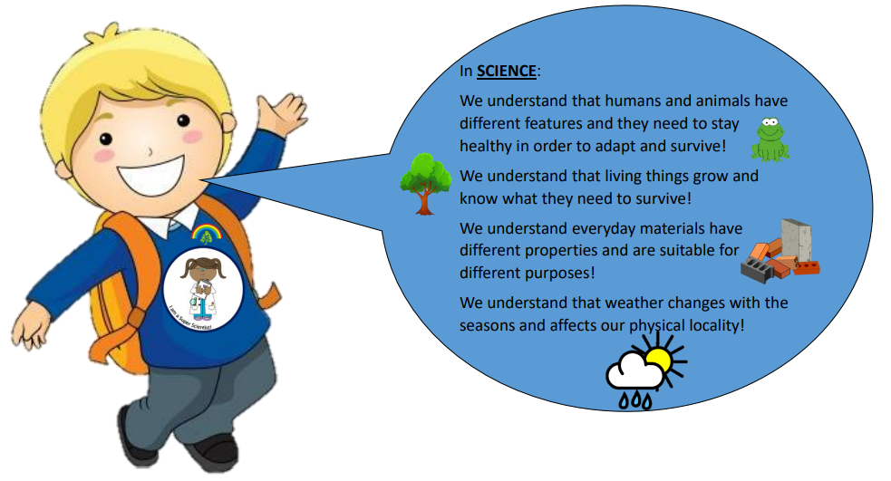
Science at GTS

Slide 4
Intent
At GTS, our children are encouraged to be curious and in Science, develop a sense of excitement and curiosity about natural phenomena, the world and how things work.
We want our children to experience and observe phenomena, looking more closely at the natural and humanly-constructed world around them. The learning possibilities at GTS are endless. We love our children to explore, with most of the learning in Science being through the use of first-hand practical experiences. Learning opportunities are everywhere in Science and we want our children to experience them all!
Support and challenge ensures that all children are able to be super scientists! The children understand that anyone can be a scientist and everyone, regardless of creed, gender, race or background, can achieve through exploration and by having strength in their own beliefs.
Our aspirational citizenship values ensure that children are respectful of equipment and each other, understanding that they have an important part to play in keeping our planet, environment and all living things safe.

Slide 5
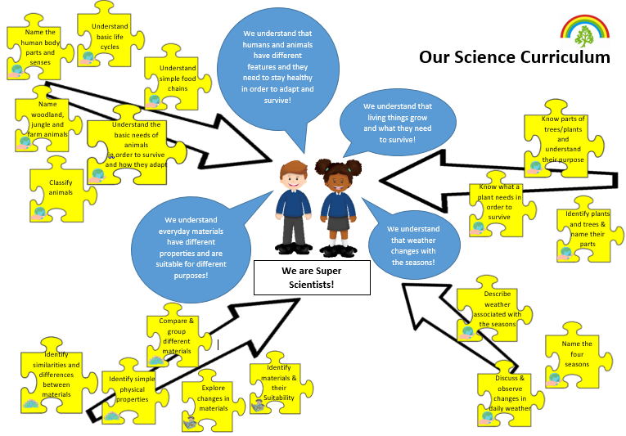
Our curriculum

Slide 6
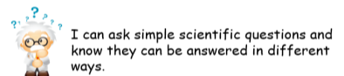
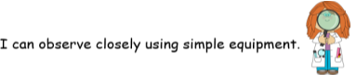
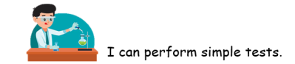
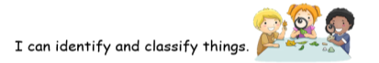
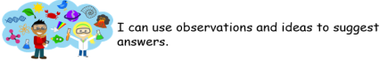
Scientific Enquiry at GTS
What scientific enquiry skill will you demonstrate today?

Slide 7


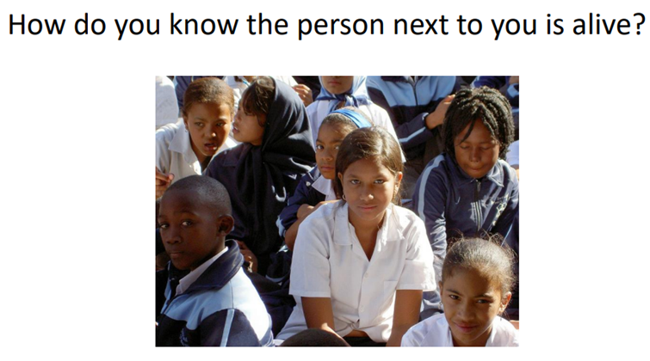
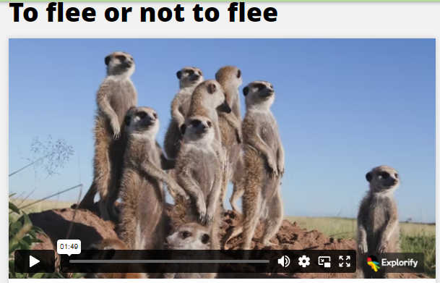
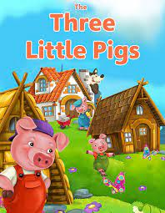
Lesson Hooks
BIG QUESTIONS
STORIES

Slide 8

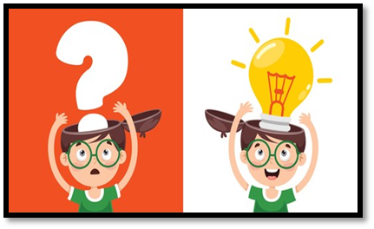

“Progress means knowing more and remembering more.”
Sticky knowledge

Slide 9
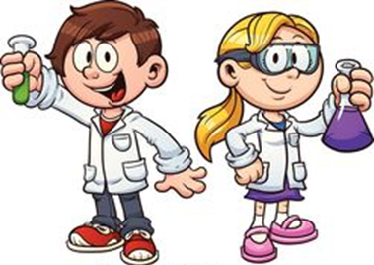
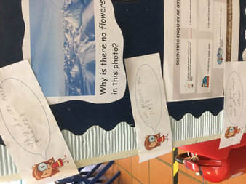
Curiosity
Young children are naturally curious and passionate about learning. They are investigators by nature who want to learn about everything they see around them. When you support your children's natural desire to explore the world in which they live, you are helping them develop a scientific mind. Encouraging your children to be curious about the natural world and asking them questions that foster that curiosity will allow them to develop an appreciation and love of all things science.

Slide 10

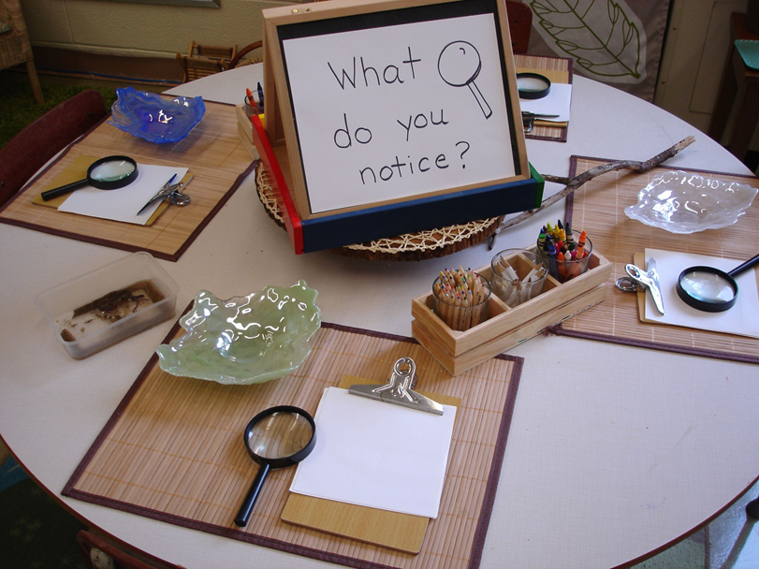
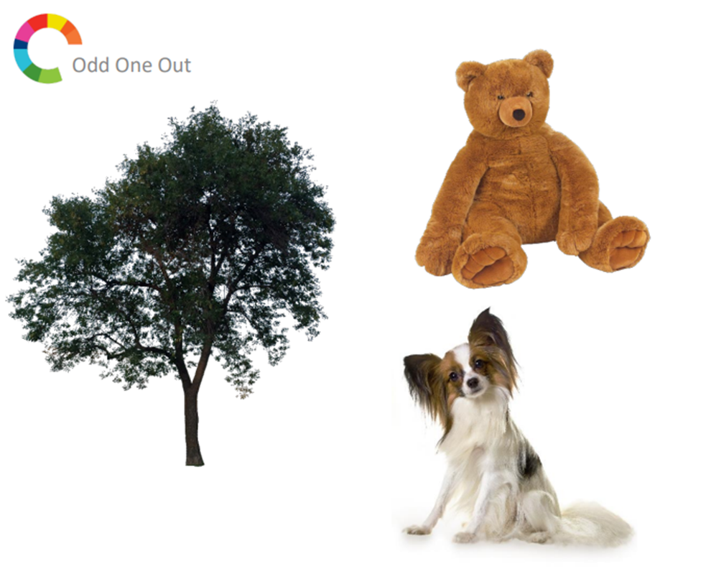
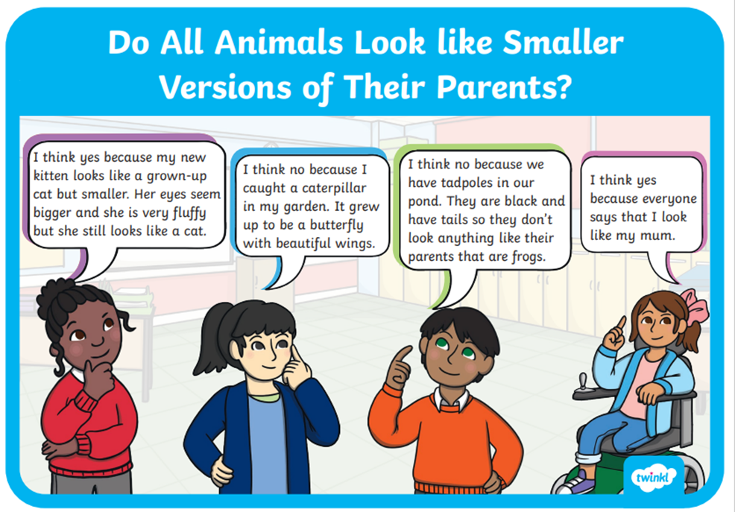
Let’s talk
Doing, thinking and talking about science is a key part of the curriculum.
Talk in early science introduces and consolidates new vocabulary and provides opportunities for children to share ideas and build understanding.
Early science talk is a key window into children’s early scientific thinking that can help us with assessment, identifying misconceptions, challenging thinking and encouraging children to justify their reasoning.

Slide 11
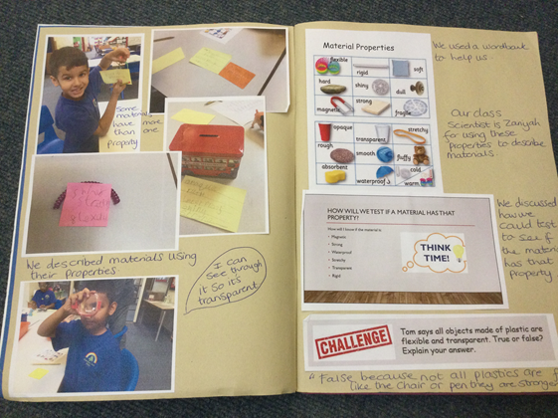
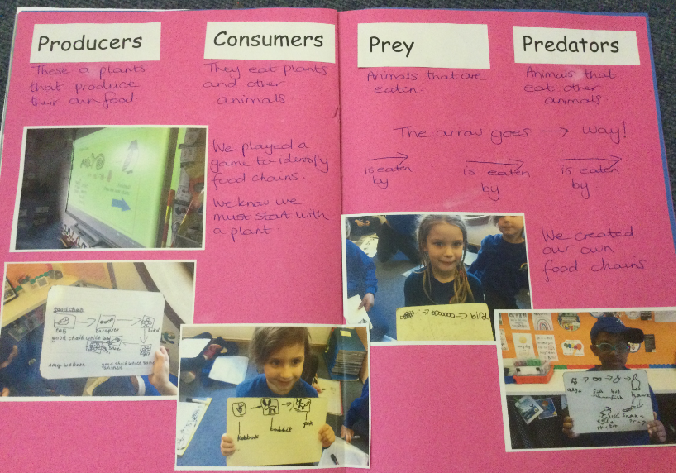
Scrap books

Slide 12
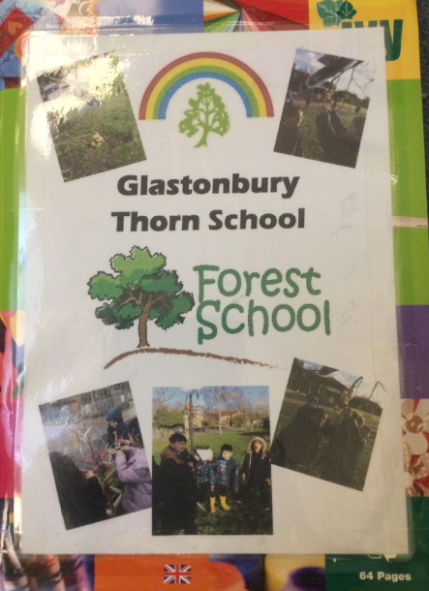
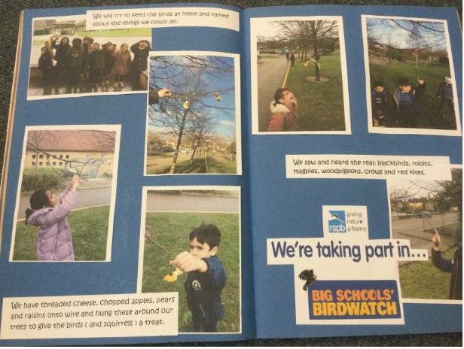
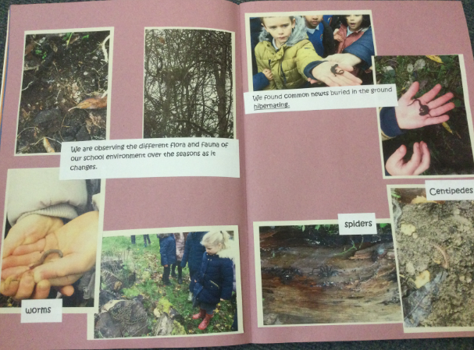
Forest Schools

Slide 13
Diversity
At GTS we provide opportunities for all children to access learning.

Slide 14

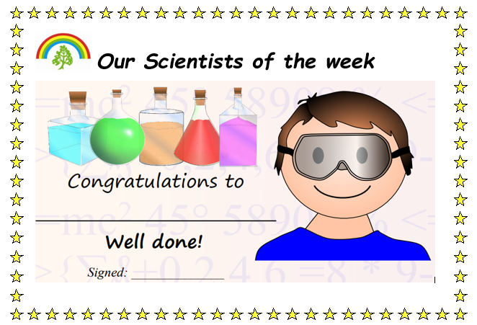
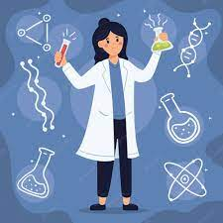

Reflection time
Who will be our class scientist today?

Slide 15

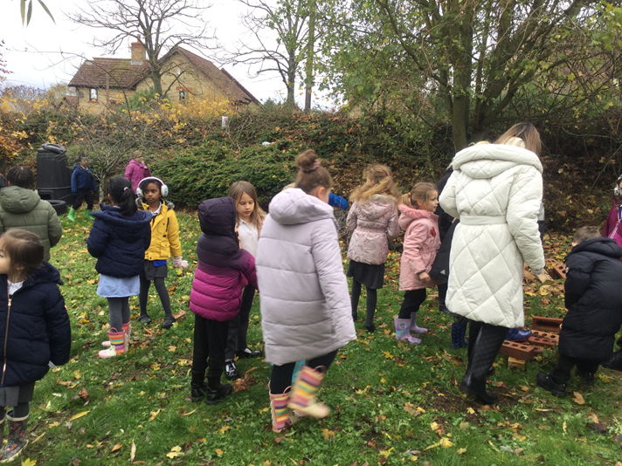

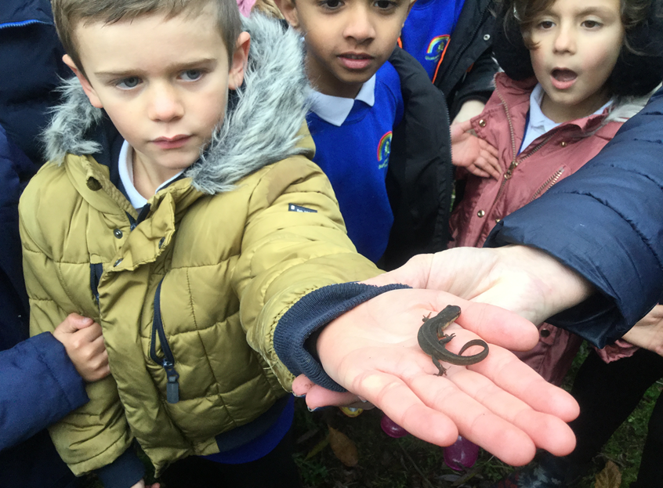
Pupil voice
“I loved being the Class
Scientist for asking lots
of questions!”
“I love science, its really fun!”
“I like it when we get to wear the lab coats!”
“It’s so much fun going to
Joshua’s garden in our Science lessons!”
“I enjoy doing investigations!”
“When I grow up I want to be a Scientist!”
“My favourite lesson was finding Newts
In Joshua’s garden!”
“I wish we could do Science everyday!”

Slide 16
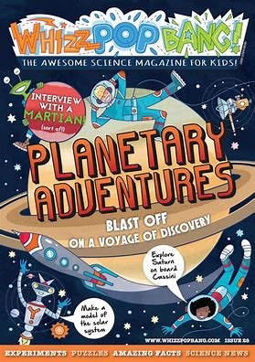
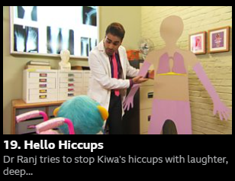
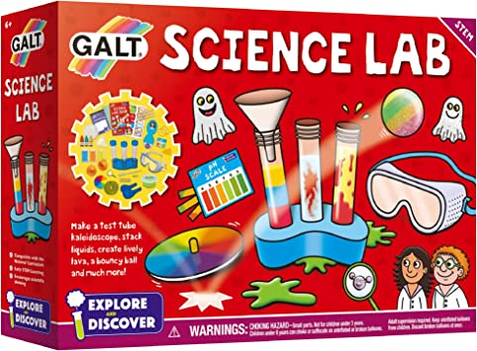
How can you help at home:
Talk science at home – ask questions and encourage your children to
ask questions about the world around them.
Taking part in practical activities and outdoor exploration,
e.g. local walk to the woods, plant seeds, talk about seasonal changes.
Read books linked to science to spark more curiosity and deepen their knowledge.
Please see handout for more ideas how you can support at home.
https://letsgolivescience.com/
BBC series ‘Get Well Soon’

Slide 17
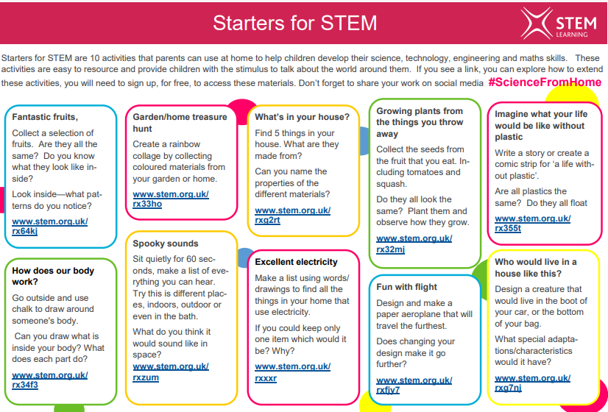
How can you help at home:
https://letsgolivescience.com/

Slide 18
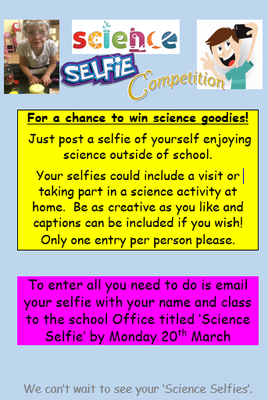
Science week Competition:

Slide 19

Thank you for your time.
Any questions?

